Slide 1
Training.

Slide 2
Evolution of Software
Machine Level Language
Assembly Level Language – Programming for 8085, 8086, 286 etc.,
High Level Language – BASIC, FORTRAN, PASCAL. C Language...
Next --> GUI like Windows OS came. C++ for object oriented programming,
Rise of Java.
Web Programming – Angular / React, HTML, CSS, Javascript.
AI – Machine Learning, Deep Learning, NLP and generative AI.

Slide 3
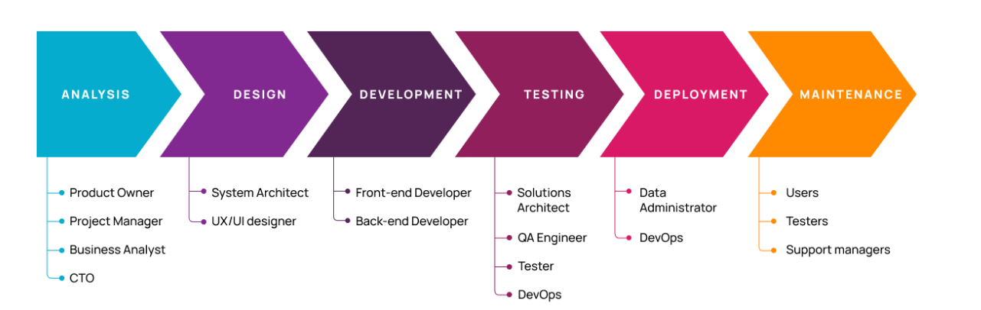
Life Cycle Phases

Slide 4
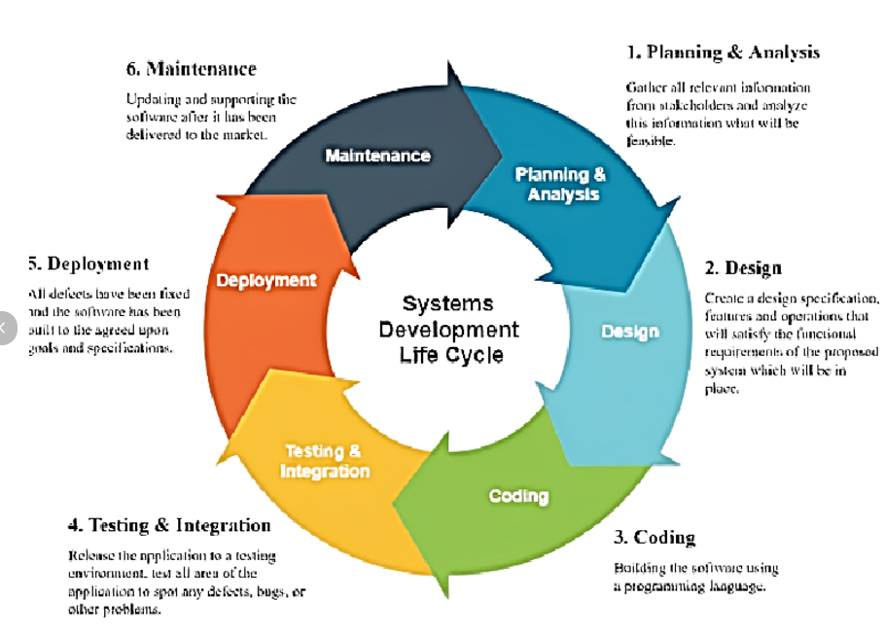
Life Cycle Phases

Slide 5
Life Cycle Phases
Planning - Define the project's goals, scope, and feasibility.
Requirement Analysis - Understand and document detailed user and system requirements
System Design : Translate requirements into a technical solution.
Development: Build the software based on the design.
Testing : Ensure the software is free from defects and meets requirements.
Deployment : Deliver the software to the end-users or production environment.
Maintenance : Ensure the software continues to perform as expected after deployment.

Slide 6
Planning Analysis
Planning and Analysis are crucial phases in the Software Development Life Cycle (SDLC). These phases lay the foundation for successful software development by identifying project goals, assessing feasibility, and gathering detailed requirements.
Key Activities:
Identify Business Goals
Feasibility Study:
Resource Allocation:
Risk Analysis:
High-Level Scheduling:
Outputs:
Project Charter, Feasibility Study Report, Initial Project Plan, Risk Analysis Document

Slide 7
Requirements Analysis
Requirements Analysis is a critical phase in the Software Development Life Cycle (SDLC) that involves gathering, analyzing, and documenting the functional and non-functional requirements of a software project.
Requirement Gathering : Collect initial requirements from the client.
Categorization of Requirements :
Functional Requirements: "The system must allow users to log in using a username and password."
Non-Functional Requirements: The system must handle 10,000 concurrent users with a response time of under 2 seconds."
Business Requirements: "The software should improve customer satisfaction by automating ticket resolution."
System Requirements: The application should be compatible with Windows, Linux, and macOS.

Slide 8
Requirements Analysis
Prioritization of Requirements : Determine which requirements are most critical.
Validation of Requirements : Ensure all requirements are accurate, complete, and aligned with business objectives.
Deliverables :
Software Requirements Specification (SRS): A formal document that consolidates all functional and non-functional requirements.
Demonstrating the SRS document

Slide 9
Design and Prototyping
Design and Prototyping are essential phases in software development, bridging the gap between requirements and implementation.
HLD – High Level Design.
LLD – Low Level Design.

Slide 10
Prototyping.
Prototyping involves creating a preliminary version of the software to gather feedback and validate concepts before full-scale development.
Steps in Prototyping:
Gather Requirements: Identify the specific features to be prototyped.
Develop Prototype: Build the model using tools or frameworks (e.g., Figma, HTML/CSS, or React).
User Feedback: Present the prototype to stakeholders or users for input.
Refine and Iterate: Make adjustments based on feedback.
Final Validation: Ensure the prototype aligns with requirements before moving to full-scale development.
Prototyping – Example of Scheneider prototyping.

Slide 11
Development of the Application
The Development Phase is the stage in the Software Development Life Cycle (SDLC) where the actual coding and creation of the software take place. It translates the designs and requirements into a functional application.
Set Up the Development Environment : Install the required tools like Visual Studio, PyCharam, Eclipse and STS etc.,
Coding : Write code for the features defined in the design phase.
Component Integration : Assemble different modules or components into a cohesive application.
Version Control and Collaboration :Use tools like Git for tracking changes and collaborating
Testing During Development :Unit Testing: Validate individual components or functions.
Documentation : Document the codebase for better understanding and maintenance
Example of Schneider Development or Web Development example.

Slide 12
Testing and Deployment
Testing and Deployment are critical phases in the Software Development Life Cycle (SDLC) that ensure the software meets quality standards and is delivered to end-users.
Types of testing.
Functional Testing: Ensures the software performs the specified functions. Examples:
Login functionality, Form validation.
Non-Functional Testing: Load Testing, performance testing.
Unit Testing: Testing the functions of the code.
Integration Testing: Integrating all the modules and testing.
User Acceptance Testing (UAT): Conducted by end-users to validate the software against business needs.

Slide 13
Testing
Testing Process:
Create test cases
Execute tests
Log Defects
Fix and retest
Generate reports.

Slide 14
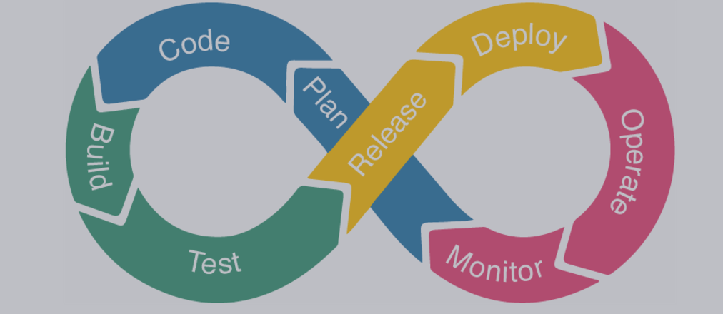
Deployment Phase
To deliver the software to the production environment, making it available for end-users.

Slide 15
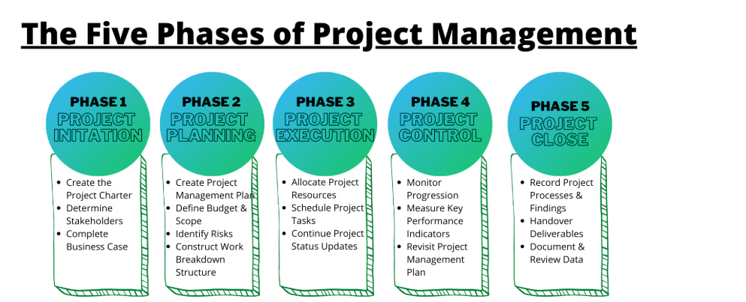
Project Management

Slide 16
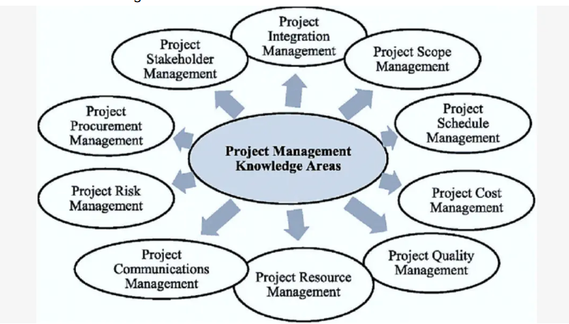
Project Management

Slide 17
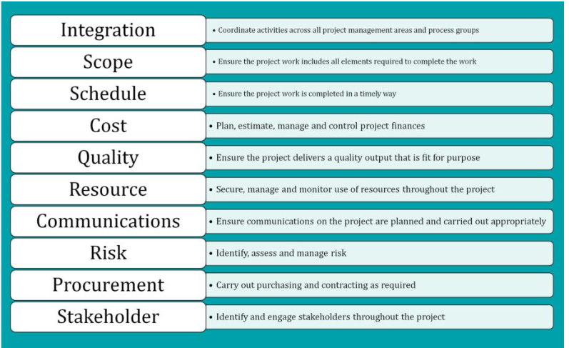
Project Management

Slide 18
Pre-code planning
Pre-code planning is the initial phase of the Software Development Life Cycle (SDLC) that focuses on preparing for actual development.
Key Activities in Pre-code Planning
Define Project Goals
Requirements Analysis
Feasibility Study
Design System Architecture
Create a Development Plan
Risk Assessment
Tool Selection : Development Tools, Dev-ops Tools,
Prototype or Wireframe Creation

Slide 19
Pseudocode
Pseudocode is a simplified, high-level description of a program's logic written in plain language or structured syntax that resembles programming constructs. It serves as an intermediate step between problem-solving and actual code implementation.
Input N --> Sum upto n.
Sum ← 0
FOR i ← 1 TO N DO
Sum ← Sum + i
ENDFOR
Output Sum

Slide 20
Verifying an Algorithm
Verifying an Algorithm in software development ensures that the algorithm is correct, efficient, and meets the specified requirements.
Steps to Verify an Algorithm:
Understand the Problem
Analyze Logic and Flow
Perform Dry Runs : Boundary cases, normal cases, edge cases etc.,
Perform Complexity Analysis : Space and time complexity
Example : Bubble Sort, Merge sort, quick sort etc., verify the algorithm.

Slide 21
Flowchart
A flowchart is a picture of the separate steps of a process in sequential order. It is a generic tool that can be adapted for a wide variety of purposes, and can be used to describe various processes, such as a manufacturing process, an administrative or service process, or a project plan.

Slide 22
DBMS, its components, and advantages for users
Database Management System (DBMS) is software that allows users to create, manage, and interact with databases efficiently. It serves as an interface between users and the database, ensuring secure, organized, and efficient data access and manipulation.

Slide 23
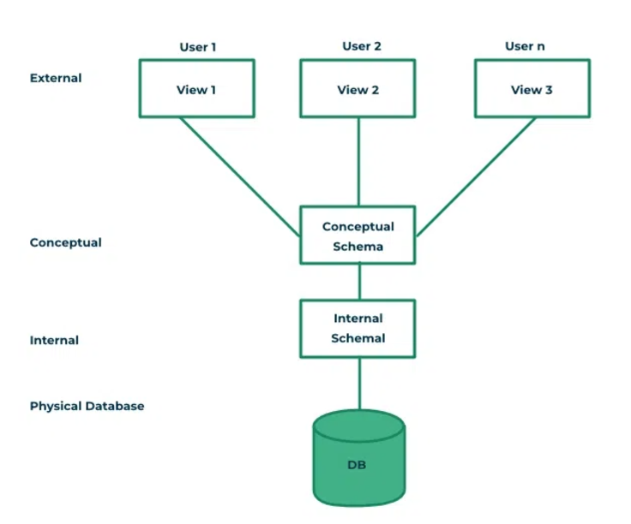
DBMS, its components, and advantages for users

Slide 24
DBMS, its components, and advantages for users
External Layer : The user layer, also called the external layer, is the topmost layer of the DBMS architecture. It provides an interface for end-users and applications to interact with the database.
Conceptual Schema : The conceptual schema describes the logical structure of the entire database. It defines the organization of data, relationships, constraints, and business rules, independent of how the data is physically stored. Lets say we have product table and user table. We are setting a relationship between product and user table that a user can order a product.
Physical Schema : The internal schema describes the physical storage of data in the database. It focuses on how data is organized, stored, and accessed on hardware like disks and memory.

Slide 25
DBMS, its components, and advantages for users
Advantages:
Data Integrity : Ensures accuracy and consistency of data across the database.
Data Security : Provides access control mechanisms to secure sensitive information.
Data Sharing: Allows multiple users to access and manipulate the data simultaneously without conflicts.
Improved Efficiency : Query optimization and indexing ensure faster data retrieval and updates.
Scalability : Accommodates increasing data volumes and user demands.
Backup and Recovery :Automated backup and recovery mechanisms protect against data loss.
Abstraction and Independence : Users interact with data through a high-level interface without needing to know the underlying storage mechanisms.
Minimizes Redundancy : Normalization reduces duplicate data, saving storage and maintaining consistency.
Cost-Effective Maintenance : Centralized management simplifies updates, backups, and hardware scaling.
Flexibility : Supports complex queries, reports, and data analysis.

Slide 26
Features and characteristics of flat-file, hierarchical, and XML database models
Flat file data model : A flat-file database organizes data in a simple table-like structure, where all information is stored in plain text or binary files without relationships between records.
Features : Simplicity, No relatioship between fields, Static schema, Redundancy.
Example : Demonstrate a flat file for Student database.
Assignment : Create a excel sheet or flat file for Customer database.

Slide 27
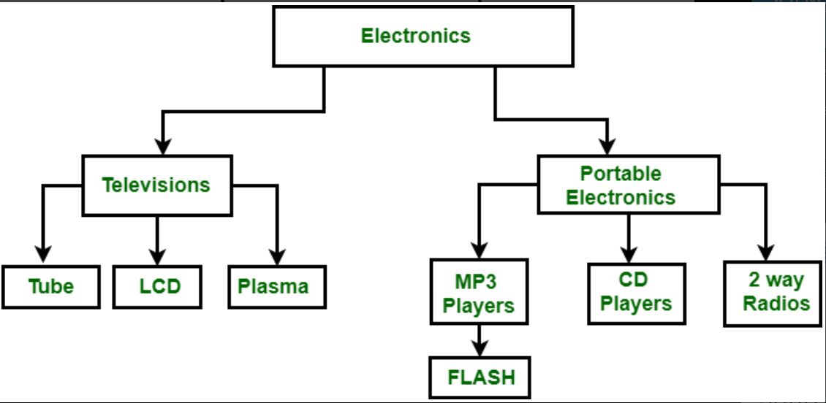
Features and characteristics of flat-file, hierarchical, and XML database models
Hierarchical Model : A hierarchical database organizes data in a tree-like structure with parent-child relationships. Each parent node can have multiple child nodes, but each child has only one parent.
Features : Tree Structure, Parent-Child Relationship.
Characteristics : Fast Access for data retrieval, Easy to travel.

Slide 28
Features and characteristics of flat-file, hierarchical, and XML database models
XML Database model : Data will be as part of XML. Format is :
<Student>
<RegistrationNo>101</RegistrationNo>
<Name>Charan</Name>
<Stream>CS</Stream>
</Student>
Features : Flexible Schema, Heirarchical Structure, Easily integrated with web technology, Querying Support, Data exchange between 2 systems.
Characteristics : High Flexible, Supports Hierarchial, Relational and hybrid models.
Assignment : Write a xml db file for any domain. List of Products in Amazon.

Slide 29
Levels of a DBMS architecture
This is discussed earlier.

Slide 30
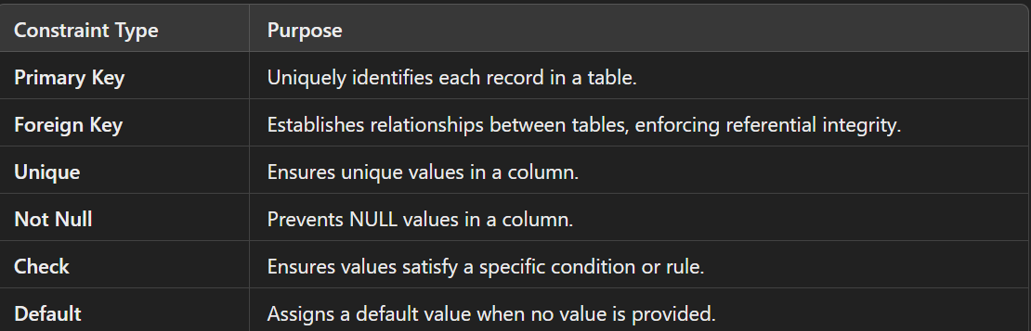
Types of constraints
In a Database Management System (DBMS), constraints are rules applied to the data to maintain its integrity and consistency. They ensure that the database adheres to specified business rules and relationships.

Slide 31
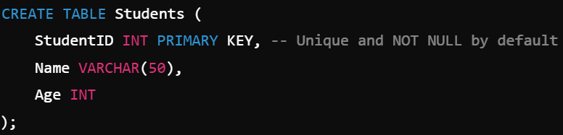
Types of constraints
Primary Key Constraint : The primary key column(s) must contain unique and non-NULL values.
Foreign Key Constraint : The foreign key column in one table must reference a primary key in another table.

Slide 32
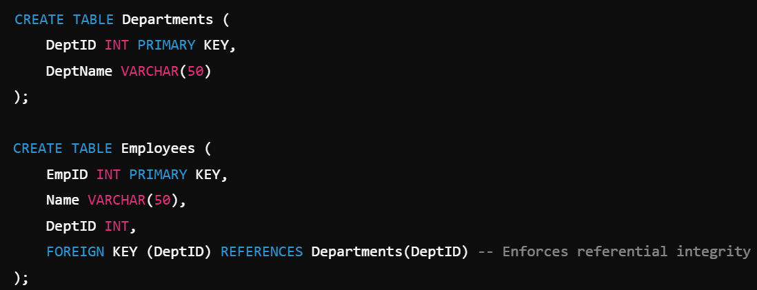
Foreign Key Constraint.

Slide 33
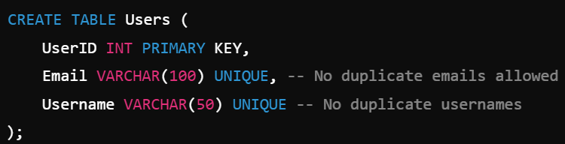
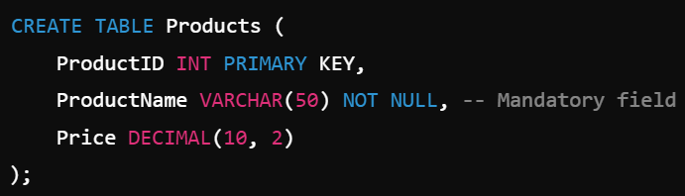
Unique constraint and Not Null constraint.
Unique Constraint : Ensures that all values in a column are unique across the table.
Not Null Constraint : Ensures that a column cannot have NULL values

Slide 34
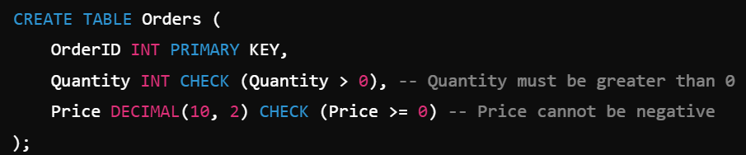
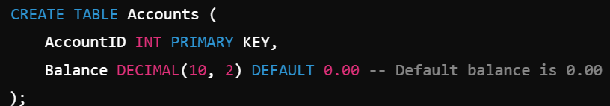
Check Constraint
Check Constraint : Ensures that a column's values meet a specified condition.
Default Constraint : Assigns a default value to a column when no value is provided during an INSERT operation.

Slide 35
Normalization.
Normalization is a systematic approach to organizing data in a database to minimize redundancy and avoid undesirable characteristics like insertion, update, and deletion anomalies. It involves decomposing tables into smaller, related tables and defining relationships between them to improve data integrity and query performance.

Slide 36
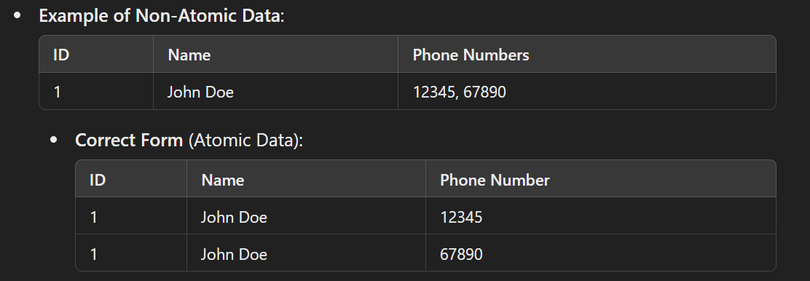
Perform first normal form
First Normal form : Each column must contain only atomic (indivisible) values. A column should not have multiple values (e.g., a list or set of values).
Assignment : Write the table with the fields Student Id, Student Name and marks. Write all the marks in the same row. Write another table which follows 1nf.

Slide 37
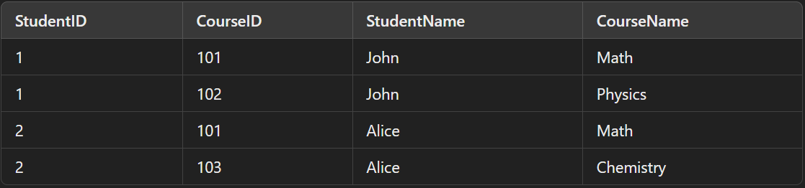
Perform second normal form
If the table data must be 1nf (should contain atomic values) and It has no partial dependencies: This means no non-prime attribute should be dependent on part of any candidate key. A non-prime attribute is a column that is not a part of the candidate key.
Simple Explanation : In 2NF, every non-prime attribute must depend on the whole candidate key, not just part of it.

Slide 38
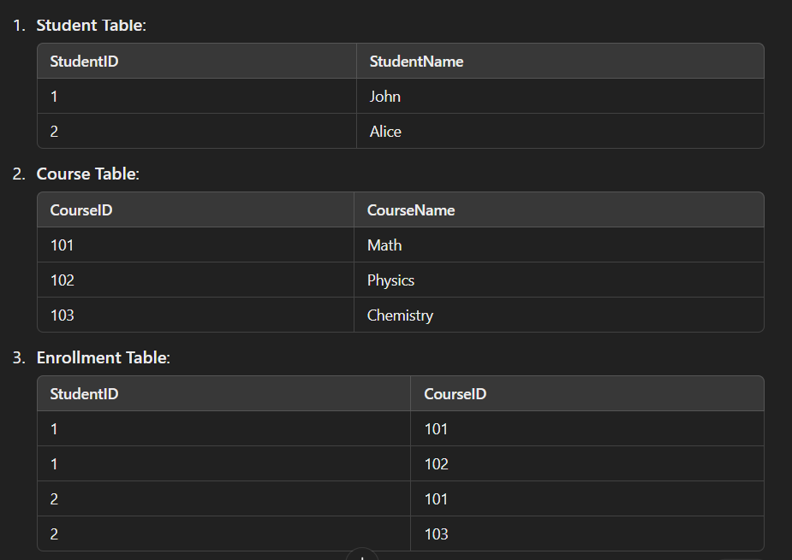
Perform second normal form
: (StudentID, CourseID) uniquely identifies each row.
Problems: StudentName depends only on StudentID. CourseName depends only on CourseID. These are partial dependencies, which violate 2NF.s, which violate 2NF. How to solve this problem

Slide 39
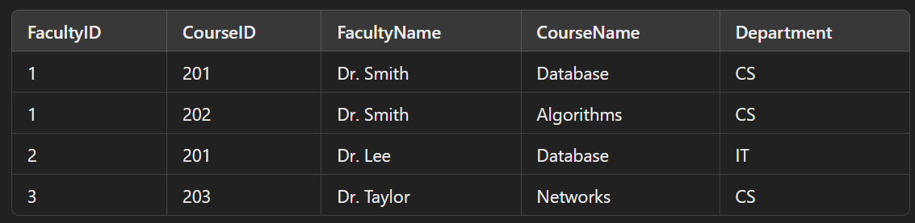
Perform second normal form
Assignment : Convert this into second normal form.

Slide 40
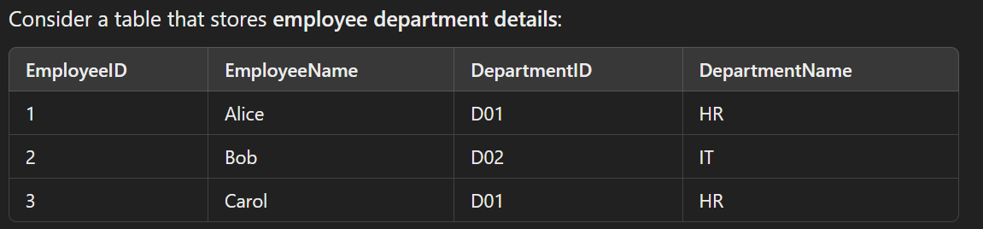
Perform third normal form
A table is in Third Normal Form (3NF) if: It is in 2NF (Second Normal Form) and
It has no transitive dependencies, meaning: A non-prime attribute (column not part of the candidate key) should not depend on another non-prime attribute. Every non-prime attribute must depend directly on the primary key.
Simple Explanation : Transitive dependency happens when a non-prime attribute is dependent on another non-prime attribute, which is in turn dependent on the primary key. To achieve 3NF, we remove such indirect dependencies.
Primary Key: EmployeeID
Problems in 2NF: DepartmentName depends on DepartmentID, not directly on EmployeeID.
This is a transitive dependency: EmployeeID → DepartmentID → DepartmentName.

Slide 41
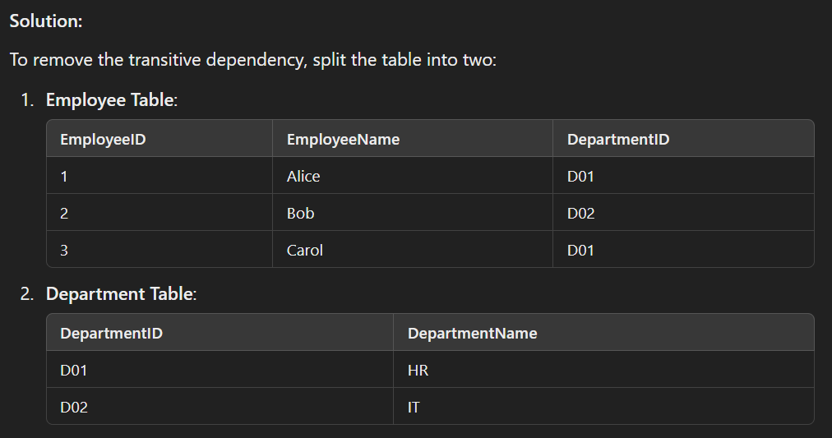
Perform third normal form

Slide 42
Perform BCNF
Boyce-Codd Normal Form (BCNF) is a stricter version of the Third Normal Form (3NF). A table is in BCNF if:
It is in 3NF.
For every functional dependency (X → Y), X is a superkey (a set of attributes that uniquely identifies a row in the table).
Why BCNF?
BCNF addresses situations where a table in 3NF might still have anomalies because of overlapping candidate keys.

Slide 43
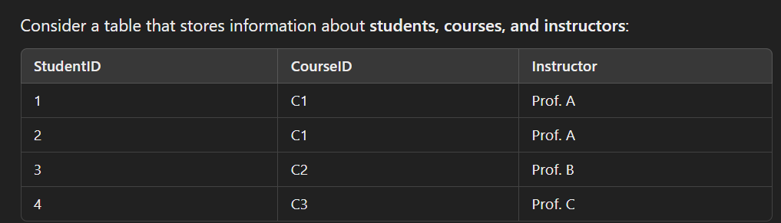
Perform BCNF
Functional Dependencies:
CourseID → Instructor (Each course is taught by one instructor.)
StudentID, CourseID → Instructor (The combination of StudentID and CourseID uniquely identifies an instructor.)
Primary Key:
(StudentID, CourseID)
Problem:
The functional dependency CourseID → Instructor means CourseID determines Instructor. But CourseID is not a superkey (it does not uniquely identify rows). This violates BCNF.

Slide 44
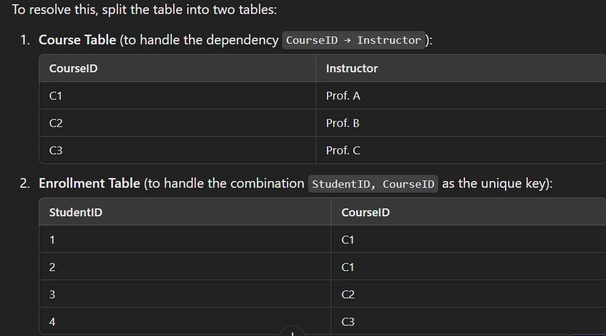
Perform BCNF

Slide 45
Describe entity-relationship modeling for a RDBMS
Entity-Relationship (ER) Modeling for RDBMS
Entity-Relationship (ER) modeling is a conceptual design process used to model the logical structure of a relational database. It provides a high-level graphical representation of the data and the relationships between different data entities. The output of ER modeling is an ER diagram (ERD).

Slide 46
Define Entities, Attributes, Relationships
Entities:
Represent real-world objects or concepts with unique identities.
Example: Student, Course, Employee.
Types: Strong Entities: Can exist independently (e.g., Student).
Attributes:
Represent properties or characteristics of an entity or relationship.
Example: A Student entity may have attributes like StudentID, Name, DateOfBirth.
Types: Simple Attributes: Cannot be divided further (e.g., Name).

Slide 47
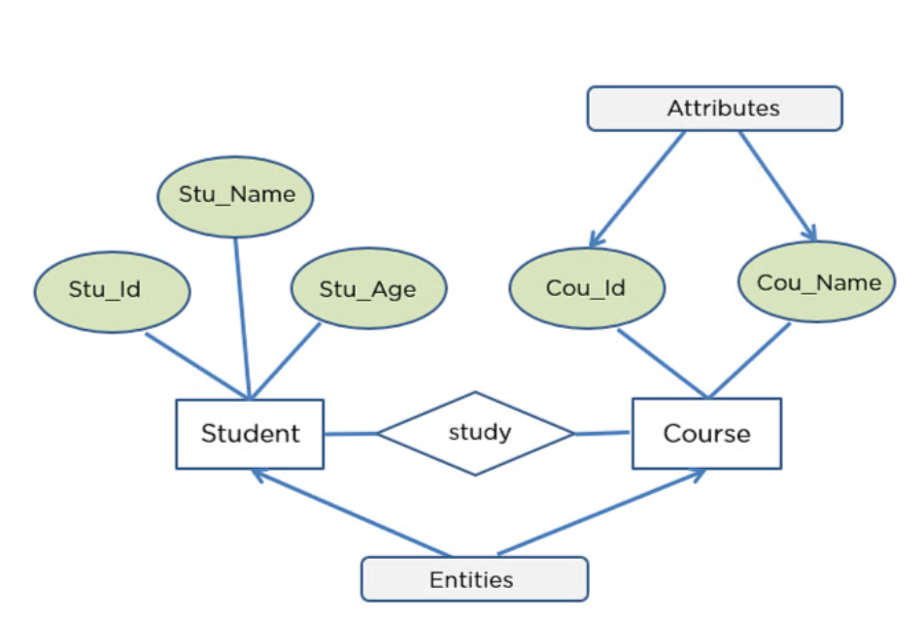
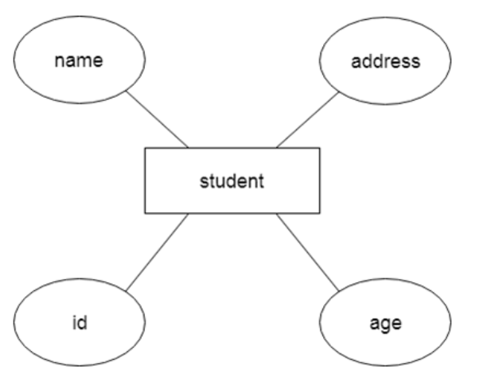
Define Entities, Attributes, Relationships

Slide 48
Define Entities, Attributes, Relationships
3. Relationships
Definition: Relationships represent associations or interactions between two or more entities.
Representation in ERD: Relationships are represented as diamonds connected to related entities.
Types of Relationships:
One-to-One (1:1):
Each instance of Entity A is related to exactly one instance of Entity B, and vice versa.
Example: Each Employee is assigned one Workstation.
One-to-Many (1:N):
Each instance of Entity A is related to many instances of Entity B, but each instance of Entity B is related to only one instance of Entity A.
Example: A Department has many Employees.
Many-to-Many (M:N):
Each instance of Entity A is related to many instances of Entity B, and vice versa.
Example: Students enroll in multiple Courses, and each Course has multiple Students.

Slide 49
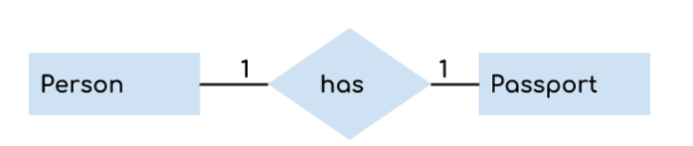
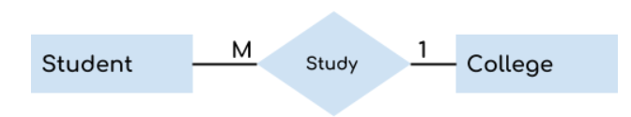
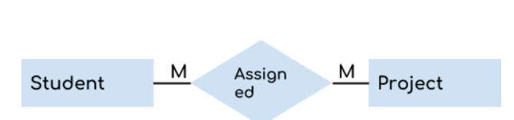
Define Entities, Attributes, Relationships
Assignment : Provide 1 to 1, 1 to M and M to M examples in 2 domains. Domain can be Student, Employee, Insurance, Library etc.,
1 to 1
1 to Many
Many to Many -

Slide 50


Degree of relationships
The degree of a relationship in an Entity-Relationship (ER) diagram refers to the number of entities that participate in the relationship. This degree helps us define the complexity of the association between entities.
Unary Relationship (Degree 1): A relationship where a single entity type is related to itself.
Binary Relationship (Degree 2): A relationship between two different entities.
Ternary Relationship (Degree 3): A relationship involving three different entities.

Slide 51
Degree of relationships
Higher-Degree Relationships (Degree > 3): Relationships involving more than three entities.

Slide 52
Cardinality of relationships
Cardinality in databases refers to the number of instances of one entity that can or must be associated with the number of instances of another entity in a relationship. It defines the nature and constraints of the relationship between entities.
Types of cardinality : 1 to 1, 1 to M and M to M.

Slide 53
Relational Database Model
The Relational Database Model is a method of structuring data using tables (also called relations) to organize and manage data in a database. It is based on the principles of relational algebra and was introduced by E.F. Codd in 1970.
Key Concepts in the Relational Database Model:
Relation (Table): A table is a collection of data organized into rows and columns.
Tuple (Row): A tuple represents a single record in a table.
Attribute (Column): Attributes are the properties or characteristics of an entity, represented as columns in a table.
Domain: A domain is the set of permissible values for an attribute. Example: The domain for Age might be integers between 0 and 120.
Primary Key:A unique identifier for each row in a table.
Foreign Key: An attribute in one table that refers to the primary key in another table, establishing a relationship between the tables.
Relation Schema: The structure of a relation, including the table name, attributes, and data types.

Slide 54
Git Essentials
Git is a distributed version control system that allows developers to track changes in their codebase, collaborate with others, and manage projects effectively. It is an essential tool for modern software development.

Slide 55
What is GIT
Provided in another PPT.

Slide 56
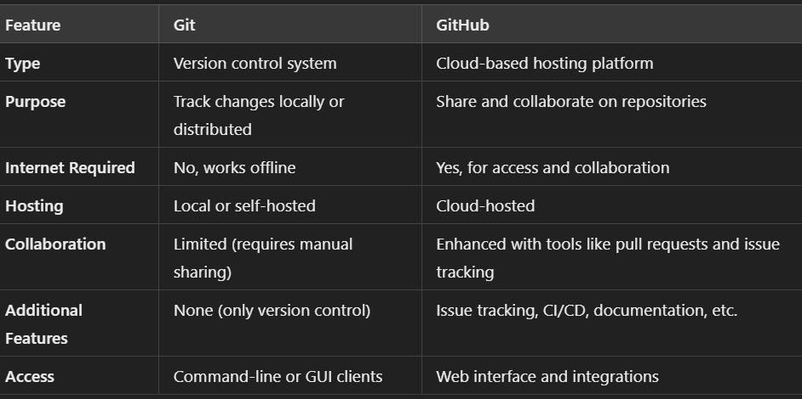
Git vs. GitHub

Slide 57
What is GitLab?
GitLab is an open-source, web-based DevOps platform that provides tools for the entire software development lifecycle, from planning to deployment. It integrates version control (using Git) with additional features like CI/CD pipelines, issue tracking, and code review tools.

Slide 58
Resolve Merge Conflicts in Git

Slide 59
What is a database
A database is an organized collection of data that is stored and managed in a way that allows easy access, retrieval, modification, and analysis. Databases are used in a wide range of applications to store information, from simple lists like a contact book to complex systems like financial records or online shopping catalogs.
Key Features of a Database:
Structured Data Storage: Data is stored in an organized manner, often in tables for relational databases.
Data Management: Enables adding, updating, deleting, and retrieving data efficiently.
Querying: Supports languages like SQL (Structured Query Language) to access and manipulate data.
Scalability: Can grow with the needs of users or organizations.
Security: Provides mechanisms to control access and protect data from unauthorized access.

Slide 60
What is SQL?
SQL (Structured Query Language) is a standard programming language designed for managing and manipulating relational databases. It is used to perform operations like querying, inserting, updating, deleting data, and managing the database structure itself.
Key Features of SQL
Declarative Language: You specify what you want to do with data, not how it should be done.
Relational Database Management: SQL works with relational databases, which organize data into tables consisting of rows and columns.
Widely Adopted Standard: Used by most relational database management systems (RDBMS) such as MySQL, PostgreSQL, Oracle, Microsoft SQL Server, and SQLite.

Slide 61
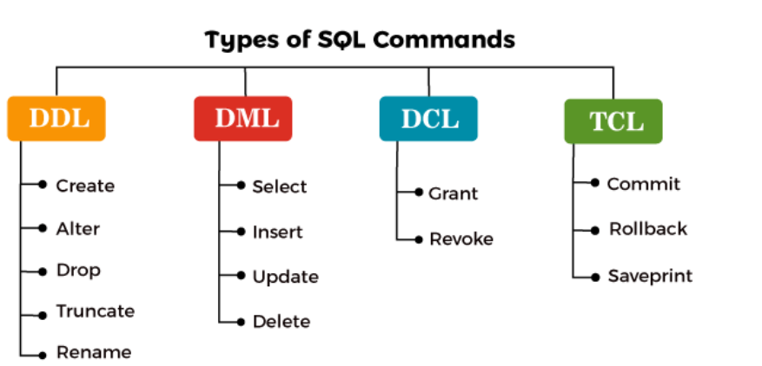
SQL Commands
SQL commands are categorized based on their functionality. Here's a breakdown of the most commonly used SQL commands grouped by their type:

Slide 62
Launch MySQL Workbench
You can launch the workbench from start menu.

Slide 63
Creating a new Database
Create database test --> Creates a new database.

Slide 64
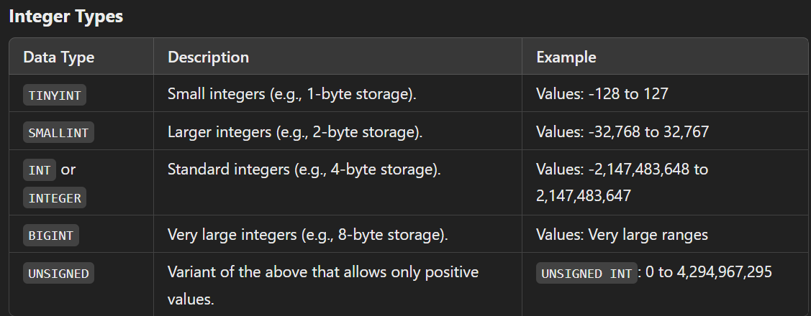
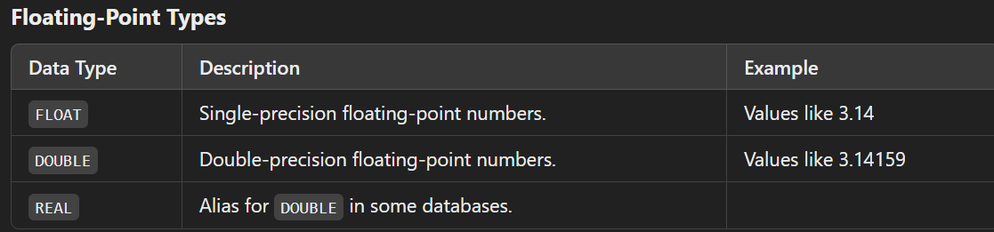
Data Types

Slide 65
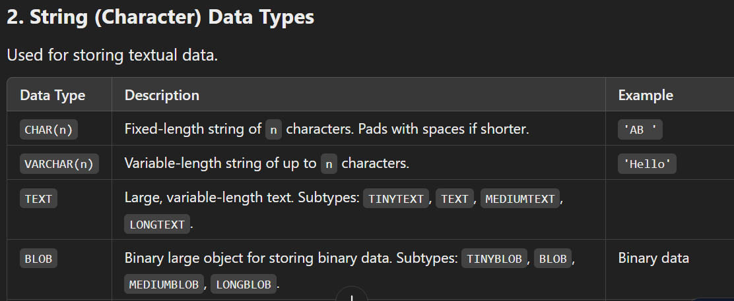
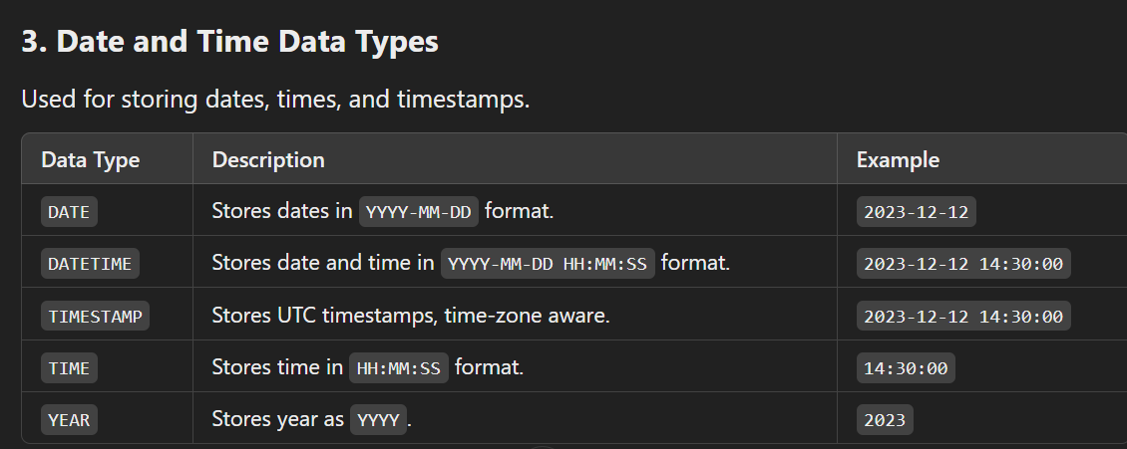
Data Types

Slide 66
CAST or CONVERT
In MySQL, CAST and CONVERT are functions used to change the data type of a value to another data type.
Use CAST for standard, portable SQL code when you don't need MySQL-specific features. Use CONVERT for character set conversions or MySQL-specific implementations.
It converts 123 into ‘123’ and displays under the header result.

Slide 67
Keys in SQL
Primary Key : A column or a group of columns that uniquely identifies each row in a table.
Foreign Key : A column (or a set of columns) in one table that refers to the primary key in another table.

Slide 68
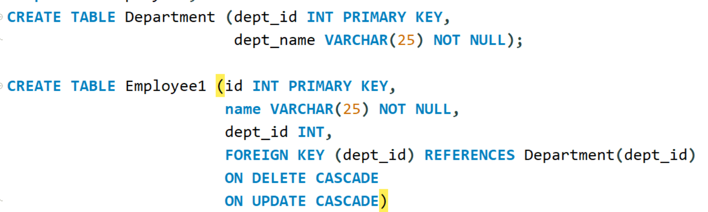
Constraints

Slide 69
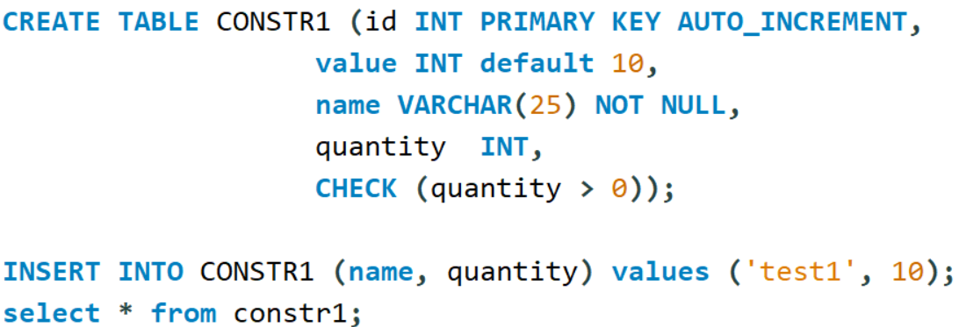
Constraints

Slide 70
DDL Commands
CREATE TABLE
ALTER TABLE
DROP TABLE <table name>
RENAME TABLE old_name TO new_name
TRUNCATE TABLE <table name>

Slide 71
Add table to Database
CREATE TABLE command.

Slide 72
Describe Table
DESC <table_name>

Slide 73
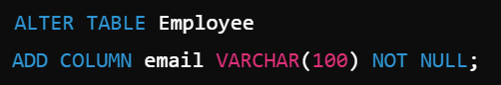
Alter Table
Alters the table structure using Alter table command.
For adding a column in the table

Slide 74
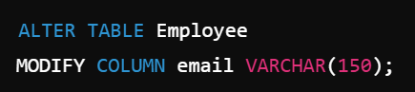
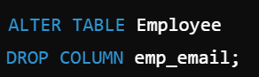
Modify and Drop Clause
For modifying a column in the table
For Dropping a column

Slide 75
Data manipulation
SELECT, INSERT, UPDATE, DELETE are considered for Data manipulation Language commands.
INSERT INTO <TABLE> Values (...);
INSERT INTO <TABLE> (Fields) VALUES (...)
INSERT INTO <table> VALUES (DEFAULT,...)
INSERT INTO <table> VALUES (NULL,...)

Slide 76
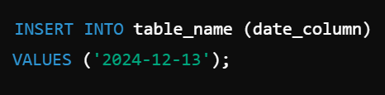
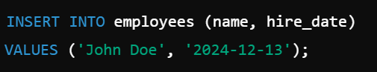
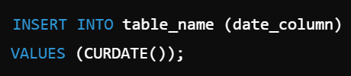
INSERT date field

Slide 77
Data manipulation
UPDATE <table name> SET value where <condition>
DELETE FROM <table> WHERE <condition>
DELETE FROM <table> -->Deletes all the rows.

Slide 78
Database schema
CREATE DATABASE
CREATE TABLE
ALTER TABLE
SHOW TABLES
DESC <TABLE NAME>

Slide 79
Import Data
Data can be imported to mysql from csv or xls file.

Slide 80
Query Clauses
All the select statements.

Slide 81
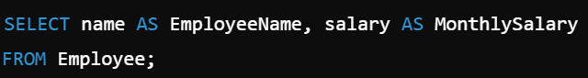
Column Alias

Slide 82
Table Alias
In Joins it is covered.

Slide 83
Introduction to joins
In SQL, joins are used to combine rows from two or more tables based on a related column. They allow you to retrieve meaningful data spread across multiple tables by defining relationships between those tables.

Slide 84
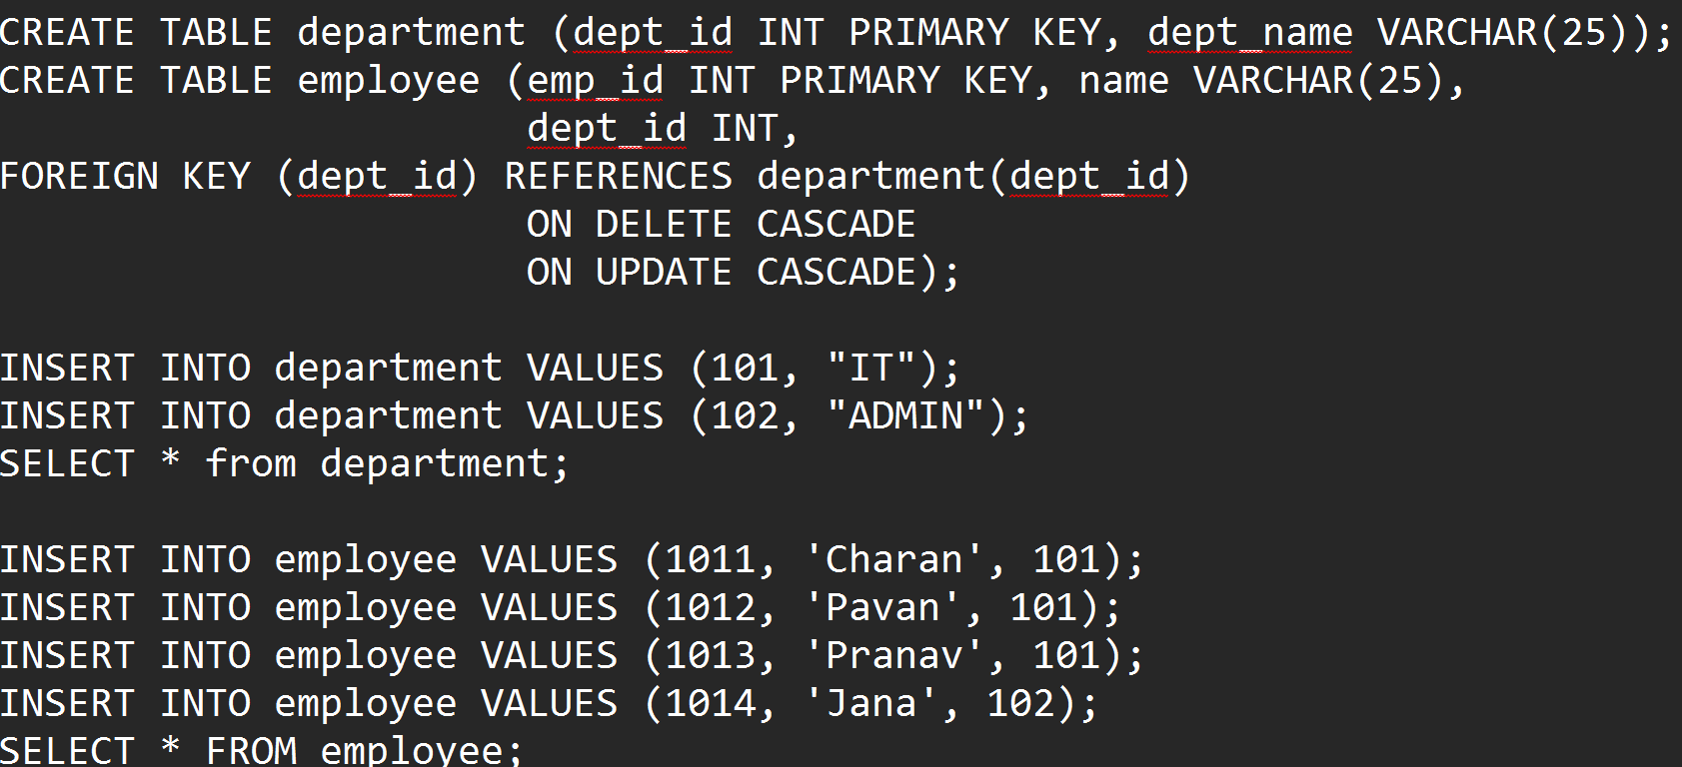
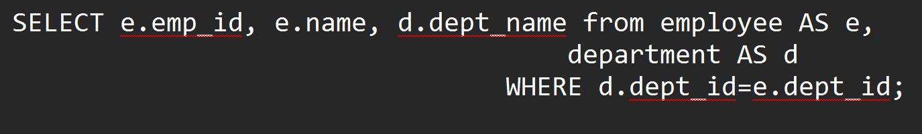
Inner Join
An INNER JOIN in MySQL combines rows from two or more tables based on a related column between them. It only includes rows where there is a match in both tables.

Slide 85
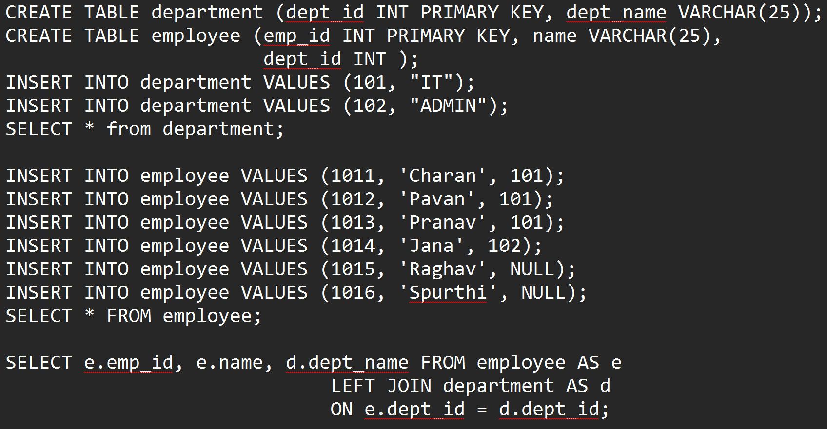
Left Outer Join
A LEFT OUTER JOIN (commonly referred to as a LEFT JOIN) in MySQL retrieves all rows from the left table (the first table in the query) and the matching rows from the right table. If there is no match in the right table, the result will include NULL for the columns from the right table.

Slide 86
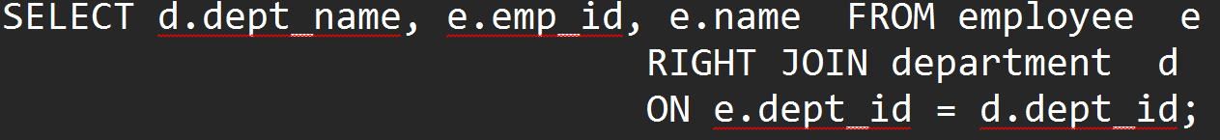
Right Outer Join
A RIGHT OUTER JOIN (commonly referred to as a RIGHT JOIN) in MySQL retrieves all rows from the right table (the second table in the query) and the matching rows from the left table. If there is no match in the left table, the result will include NULL for the columns from the left table.

Slide 87
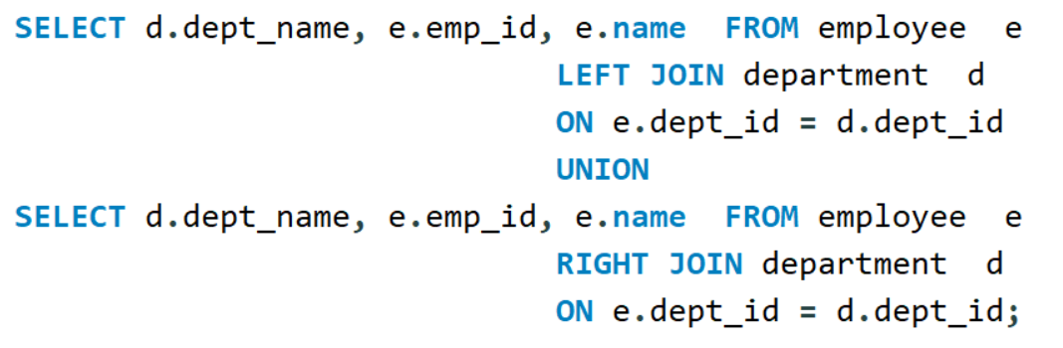
Full outer Join
A FULL OUTER JOIN retrieves all rows from both tables. If there is a match between the two tables, the rows are combined. If there is no match, NULL values are included for the columns from the non-matching table. MySQL does not natively support FULL OUTER JOIN. However, you can achieve the same result using a combination of LEFT JOIN and RIGHT JOIN with a UNION operator.

Slide 88
ANSI Join Syntax
The ANSI SQL join syntax is a standard way to write JOIN operations in SQL, which ensures compatibility across different database systems like MySQL, PostgreSQL, SQL Server, and Oracle.
It uses explicit JOIN keywords to combine tables, replacing older "comma-style joins" (non-ANSI joins), which rely on the WHERE clause.

Slide 89
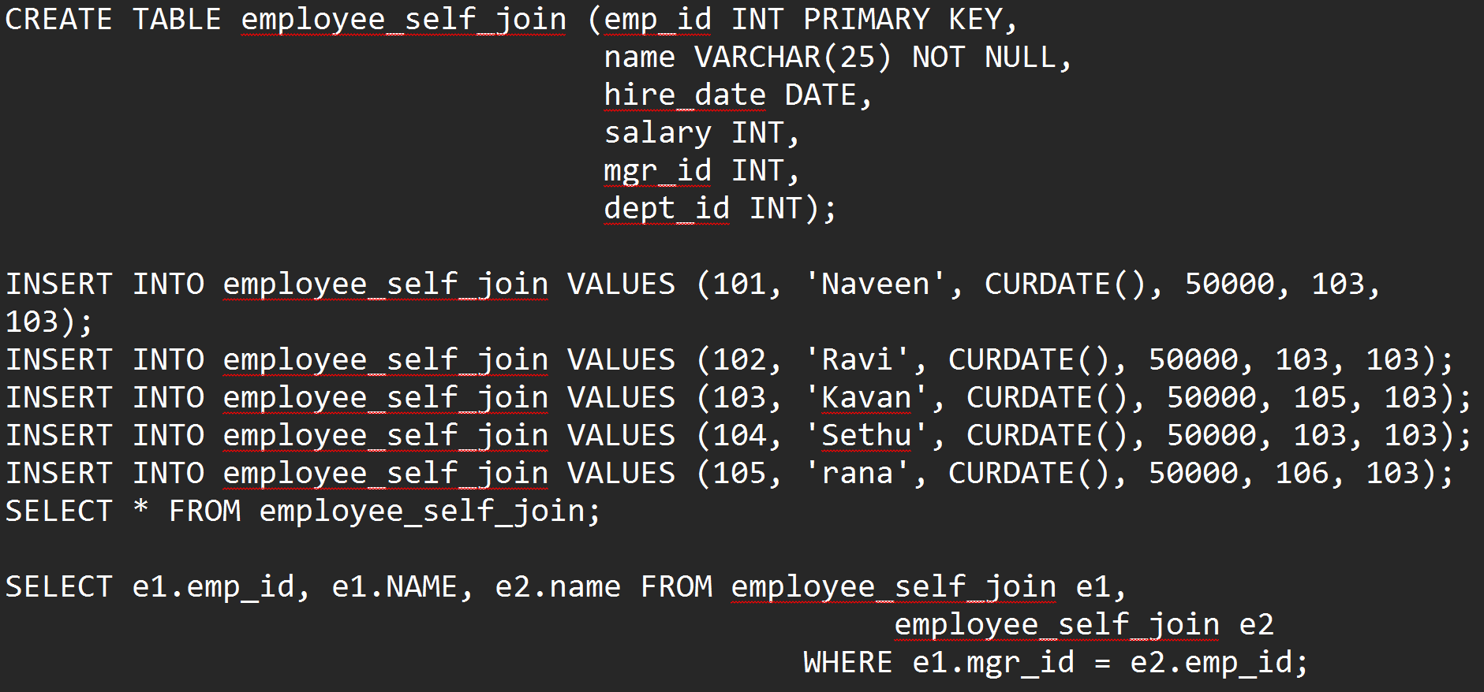
Self-Join

Slide 90
Equi and non-equi Join
Equi Join : An equi join uses an equality (=) operator to match rows between tables based on a common column.
Non-Equi Join : A non-equi join uses a comparison operator other than = (e.g., <, >, <=, >=, !=) in the join condition.

Slide 91
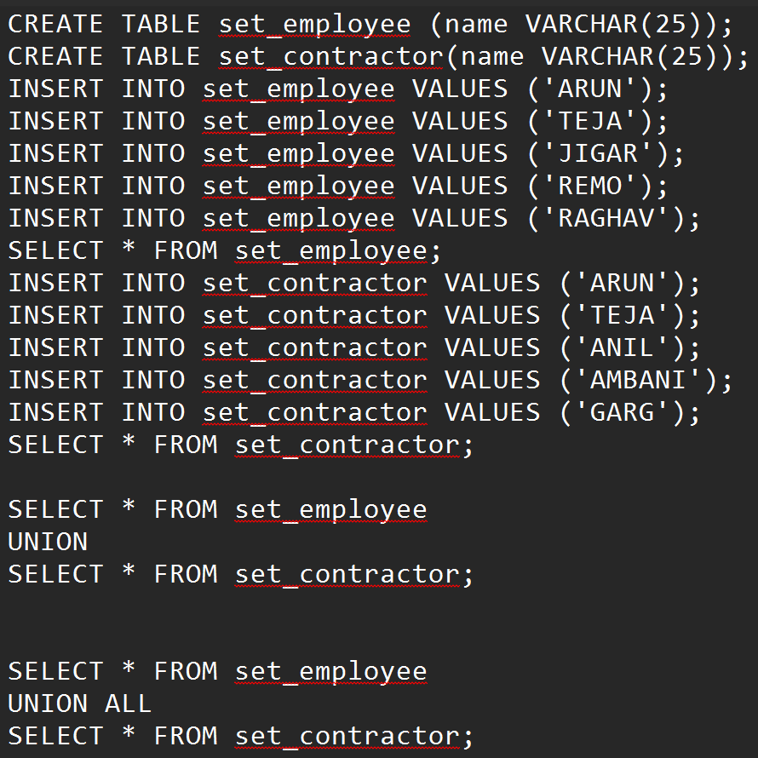
Set Operations
UNION – Combines two queries results removing the duplicates. UNION All displays combining both the queries without removing the duplicates.

Slide 92

Set Operations
INTERSECT is the matching records between both the queries but MYSQL does not support INTERSECT. Workaround can be written. Minus is first query result – second query result. Even this is not supported by mysql. For this operation also workaround can be found.

Slide 93

String Functions

Slide 94

Numeric Functions

Slide 95

Date Functions

Slide 96

Date Functions

Slide 97
Aggregate Functions

Slide 98

Generate Groups
Grouping in MySQL is achieved using the GROUP BY clause. This allows you to aggregate rows based on one or more columns and apply aggregate functions like SUM(), AVG(), COUNT(), MAX(), or MIN().

Slide 99

SQL subqueries
A subquery in SQL is a query nested within another SQL query. Subqueries can be used in various clauses like SELECT, FROM, and WHERE to retrieve data that will be used by the main query.

Slide 100

Subqueries
What is the differenc between these two queries. What would be result of it.

Slide 101
Correlated subqueries
In MySQL, correlated subqueries are a type of subquery where the subquery depends on the outer query for its values. Unlike a simple subquery, which can execute independently, a correlated subquery is executed repeatedly—once for each row being considered by the outer query.

Slide 102
Non-correlated subqueries
A non-correlated subquery in MySQL is a subquery that is independent of the outer query. This means the subquery can be executed on its own and does not rely on values from the outer query. It is essentially a self-contained query that returns a result set to be used by the outer query.

Slide 103

Views
In MySQL, a view is a virtual table based on the result of a SELECT query. Views do not store data themselves but display data retrieved from one or more tables. They are used to simplify complex queries, enhance security by restricting access to specific data, and improve query reusability.

Slide 104

Index
In MySQL, an index is a database object that improves the speed of data retrieval operations on a table. An index creates a pointer to the data in the table, which speeds up the query execution time by allowing MySQL to locate rows quickly without scanning the entire table. MYSQL uses B-Tree to construct the index for the faster access.

Slide 105

Transaction Control Commands
COMMIT: Finalizes and commits all changes made in the current transaction to the database.
ROLLBACK: Undoes all changes made in the current transaction, effectively discarding all modifications from the transaction.
SAVEPOINT: Sets a savepoint within the current transaction. It allows you to mark a specific point in a transaction.

Slide 106


Transaction Control Commands

Slide 107

Stored procedures
A stored procedure in MySQL is a set of SQL statements that you can save and reuse. It allows you to encapsulate a set of SQL queries into a single unit, making your database operations more organized and efficient.

Slide 108
Difference between Procedure and Function
Procedure : A stored procedure is a set of SQL statements that can be executed as a batch to perform a specific task. It can include data manipulation operations, control-of-flow statements, and local variable declarations.
--> Usage: Procedures are generally used for tasks that need to be repeated multiple times, like inserting, updating, or deleting multiple rows of data.
Function : A stored function is a single SQL statement or a series of SQL statements that returns a single value to the caller.
--> Usage: Functions are used for calculations or transformations that return a single result, like calculating an aggregate value, or transforming input parameters.

Slide 109

Creating a Procedure

Slide 110

Creating a Function
DETERMINISTIC: The function always produces the same result for the same input and doesn't depend on any outside or changing state (like system time, user settings, or data that might change). For your square function, this attribute is appropriate.).
MYSQL is expecting DTERMINISTIC for the function.

Slide 111
Introduction to Java
Java is a popular, versatile, and powerful programming language used widely for developing applications ranging from mobile apps to large-scale enterprise systems. Its design emphasizes simplicity, portability, and security, making it a favorite among developers and organizations.

Slide 112

Introduction to Java

Slide 113

JVM Architecture

Slide 114

Installation of Java, Configuring SDE Eclipse, Understanding how JRE and JVM works

Slide 115

Installation of Java, Configuring SDE Eclipse, Understanding how JRE and JVM works

Slide 116

Class Structure
In Java, a class is a blueprint for creating objects. It defines the properties (fields) and behaviors (methods) that an object will have.
Basic Syntax of class

Slide 117

Java Keywords

Slide 118

Primitive data types

Slide 119

Primitive data types

Slide 120
Creating primitive variables
Creating primitive variables in Java involves declaring a variable with a primitive data type and optionally assigning it a value.

Slide 121

Using operators

Slide 122
Using if-else and switch statements
In Java, if-else and switch statements are used for control flow based on conditions. Here's an explanation with examples for both:
Programs with if and switch statements.

Slide 123

Iterating with loops: while, do-while, for, enhanced for

Slide 124

Wrapper Classes and Autoboxing concepts
Wrapper Classes and Autoboxing are key concepts in Java related to handling primitive types as objects.
Autoboxing : Autoboxing is the automatic conversion that the Java compiler makes between primitive types and their corresponding wrapper class objects. When a primitive value is used where an object of the wrapper class type is expected, Java automatically converts the primitive to its corresponding wrapper class instance.
Unboxing : Unboxing is the reverse process where a wrapper object is automatically converted back to its corresponding primitive type. This occurs when a wrapper object is used where a primitive type is expected.

Slide 125
Working on Constructors
In Java, constructors are special methods used to initialize objects. They are automatically called when an object of a class is created. Constructors play a key role in setting up initial values for instance variables and performing other setup tasks.
Characteristics of Constructors
A constructor name must match the class name.
It does not have a return type, not even void.
It is automatically called when an object is instantiated using the new keyword.
If no constructor is defined, Java provides a default constructor.
Types of constructor
1. Default constructor
2. Parameterized constructor – You can have both as overloaded constructors.
Program on : Employee with 4 attributes initializing default value and parameterized data.

Slide 126
Achieving Encapsulation
Encapsulation in Java is one of the four fundamental Object-Oriented Programming (OOP) principles (the others being inheritance, polymorphism, and abstraction). It is the process of hiding the internal details of a class and only exposing a controlled interface to interact with the data.
Encapsulation is achieved by:
Declaring class variables (fields) as private.
Providing public getter and setter methods to access and update the values of private fields.
Why Encapsulation?
Data Hiding: Prevents direct access to the internal representation of the object.
Control Access: You can control which fields are read or modified.
Flexibility: You can change the implementation without affecting the external code.
Maintainability: Code is easier to manage and debug.
Example : Create a student class with roll_no and name as the private fields with getter and setter methods. Access the data for them and display it in functions.

Slide 127
Code Reusability via Inheritance
In Java, code reusability is one of the most important features of Object-Oriented Programming (OOP), and it can be achieved through Inheritance. Inheritance allows one class to inherit the fields (attributes) and methods (behavior) of another class, thereby promoting reusability and reducing redundancy in the code.
What is Inheritance?
Inheritance is a mechanism in which one class acquires the properties (fields) and behaviors (methods) of another class.
The class that is being inherited is called the parent class (superclass).
The class that inherits the parent class is called the child class (subclass).
How Inheritance Promotes Code Reusability
Eliminates Duplication: Instead of writing the same code multiple times, you can define it in one class (superclass) and reuse it in multiple subclasses.
Extensibility: New functionality can be added in subclasses without modifying the existing code in the superclass.
Maintainability: Centralized code in the superclass reduces effort when debugging, updating, or modifying common functionality.

Slide 128
Code Reusability via Inheritance
Example :
(a) Parent and child class.
(b) Parent and child class with constructors.
(c) Vechile – Basic functions... Car – Added functions, Bike – Added functions.

Slide 129

Code Reusability via Inheritance

Slide 130
Achieving Polymorphism
Polymorphism is one of the four main pillars of Object-Oriented Programming (OOP) in Java (along with Encapsulation, Inheritance, and Abstraction). It allows a single action or method to behave differently based on the object that calls it.
Polymorphism in Java can be achieved in two main ways:
Compile-Time Polymorphism (Static Polymorphism)
Run-Time Polymorphism (Dynamic Polymorphism)

Slide 131

Static Polymorphism – Method Overloading
Compile-Time Polymorphism (Method Overloading) : Compile-Time Polymorphism occurs when a class has multiple methods with the same name but different parameters (method overloading). The method to be called is resolved at compile-time.

Slide 132
Runtime Polymorphism – Method Overriding
Run-Time Polymorphism (Method Overriding) : Run-Time Polymorphism occurs when a subclass provides a specific implementation for a method that is already defined in its parent class. It is achieved using method overriding. The method to be executed is resolved at run-time using dynamic method dispatch. This is commonly used with inheritance and interfaces.
Example : Procide car –BMW and Merc Example.

Slide 133
Working on methods of java.lang.Object class
In Java, every class inherits from the Object class, which provides a set of essential methods. Some of the most commonly used methods are:
toString(): Returns a string representation of the object.
equals(Object obj): Compares the object with another object for equality.
hashCode(): Returns a hash code value for the object.
getClass(): Returns the runtime class of the object.
clone(): Creates a copy of the object (if the class implements the Cloneable interface).
notify(): Wakes up a single thread that is waiting on this object's monitor.
notifyAll(): Wakes up all threads that are waiting on this object's monitor.
wait(): Causes the current thread to wait until another thread invokes the notify() or notifyAll() method for this object.
Example : On toString() and clone().

Slide 134
Object Casting
In Java, object casting is the process of converting one object type into another. It is primarily used when dealing with inheritance and polymorphism. Java provides two types of casting:
Upcasting : Upcasting refers to casting a subclass object to a superclass type. It happens automatically and does not require explicit casting because the subclass is always a type of the superclass. We have doen this in the previous example of car.
Downcasting : Downcasting refers to casting a superclass reference to a subclass type. This is not done automatically and requires explicit casting because not all superclass objects are instances of the subclass.

Slide 135

Downcasting example :

Slide 136
Passing Objects as Arguments
In Java, objects can be passed as arguments to methods, allowing you to work with data contained within those objects. When you pass an object as an argument to a method, you are passing the reference to that object, not the actual object itself.
Key Points About Passing Objects as Arguments
Objects are passed by reference: This means that the reference (memory address) to the object is passed, not a copy of the object.
Changes to the object inside the method affect the original object: Since the method works with the same object, any modifications to it are reflected outside the method.
Java is "pass-by-value": Technically, Java passes the reference value (not the actual reference itself). However, the effect for objects is similar to "pass-by-reference."
Example : Swap data in an object by passing object to a function.

Slide 137
Abstraction via Abstract Classes and Interfaces
In Java, abstraction is a fundamental concept that allows you to hide the implementation details of a class and expose only the necessary details to the user. This can be achieved through abstract classes and interfaces.
Abstract Classes
An abstract class is a class that cannot be instantiated on its own and is used only as a base for other classes.
It can contain both abstract methods (methods without a body) and non-abstract methods.
Abstract methods must be implemented by the subclass.

Slide 138



Slide 139
Interfaces
Interfaces : In Java, interfaces provide a way to achieve abstraction by defining a contract that classes must follow. They allow you to define the what (methods) but not the how (implementation). This enables decoupling and promotes code flexibility.
In Java, interfaces provide a way to achieve abstraction by defining a contract that classes must follow. They allow you to define the what (methods) but not the how (implementation). This enables decoupling and promotes code flexibility.
Key Characteristics of Interfaces
Full Abstraction: Interfaces in Java are fully abstract, meaning they cannot have method implementations (except default or static methods since Java 8).
Multiple Inheritance: A class can implement multiple interfaces, overcoming the single-inheritance limitation of classes.
Default Methods: From Java 8, interfaces can include default methods with implementation.
Static Methods: Interfaces can have static methods that belong to the interface itself.
Example : Interface with a method implements in a class. Implement Sum and product using interfaces.

Slide 140


Interfaces

Slide 141

Diamond Problem using Interfaces.
The Diamond Problem in Java occurs when a class implements multiple interfaces that have methods with the same signature. This can cause ambiguity in which method implementation to choose when an object references the class.
In the below given example, how Class C can implement the show() of both interface A and Interface B.

Slide 142

Solving Diamond interface problem.

Slide 143
Creating Static Classes and Static Methods
Static Method : A static method belongs to the class itself rather than any instance of the class. It can be invoked without creating an object of the class.
Static Class : In Java, static classes can only be defined as static nested classes. This means that a class marked as static must be nested within another class because top-level classes cannot have the static modifier.

Slide 144

Static Class Example :

Slide 145

Single-Dimensional Array
A single-dimensional array in Java is a data structure that can store a fixed-size sequence of elements of the same data type. It is essentially a collection of elements accessed by a single index.
Creating the array :
Example : Sum of all the element in the array.

Slide 146

Multi-Dimensional Arrays
In Java, multi-dimensional arrays are arrays of arrays. They are used to store data in a grid or matrix format. Multi-dimensional arrays are primarily two-dimensional but can be extended to three or more dimensions as needed.
Declaring and printing 2 x 2 matrix

Slide 147
Array of Objects
An Array of Objects in Java is a collection where each element is an object. Java arrays can hold any data type, including objects, which makes them useful for organizing and managing multiple instances of a class.
Example : Array of students and display them.

Slide 148

Arrays utility class

Slide 149


String Class
The String class in Java is one of the most commonly used classes in the Java programming language. It is part of the java.lang package and represents an immutable sequence of characters.
Key Features of the String Class:
Immutability: Once a String object is created, its content cannot be changed. Any operation that modifies a String (e.g., concatenation, replacement) creates a new String object.
Example : On the functions of String.

Slide 150

String Class

Slide 151
StringBuffer class
The StringBuffer class in Java is part of the java.lang package and is used to create mutable (modifiable) sequences of characters. Unlike the String class, which creates immutable objects, StringBuffer allows for efficient modifications such as insertions, deletions, and appends without creating a new object.
Key Features of StringBuffer
Mutability: You can modify the contents of a StringBuffer object without creating a new object.
Thread-Safe: All methods of StringBuffer are synchronized, making it thread-safe.
Dynamic Memory Allocation: The buffer grows dynamically as needed when new characters are added.

Slide 152

StringBuffer class

Slide 153
StringBuilder class
The StringBuilder class in Java is a part of the java.lang package and provides a mutable sequence of characters. Unlike String, which is immutable, StringBuilder allows you to modify strings without creating new objects, which makes it more efficient for situations where frequent modifications to string content are required.
Features of StringBuilder:
Mutable: You can modify the content of a StringBuilder object without creating a new one.
Efficient: It is faster than String for concatenation and other modifications because it doesn't create new objects.
Not Thread-Safe: Unlike StringBuffer, StringBuilder is not synchronized, making it more suitable for single-threaded scenarios.

Slide 154
StringBuilder class
public class StringBuilderExample {
public static void main(String[] args) {
StringBuilder sb = new StringBuilder("Welcome");
sb.append(" to Java");
sb.insert(11, " Programming");
sb.replace(0, 7, "Hello");
sb.delete(5, 11);
System.out.println(sb); // Output: HelloProgrammingJava
}
}

Slide 155
Introduction to Regex (Regular Expression)
Regular expressions (Regex) in Java are powerful tools used for pattern matching and text manipulation. They are implemented through the java.util.regex package and allow developers to define search patterns for strings.
Key Classes in java.util.regex:
Pattern:
A compiled representation of a regular expression.
Use the Pattern.compile(String regex) method to create a Pattern object.
Matcher:
An engine that performs match operations on a character sequence using a Pattern.
Created by calling pattern.matcher(CharSequence).
PatternSyntaxException:
Thrown when there is a syntax error in the regular expression.

Slide 156


Introduction to Regex (Regular Expression)

Slide 157
Defining the purpose of Java exceptions
The primary purpose of Java exceptions is to provide a mechanism for managing errors and other exceptional conditions that arise during the execution of a program.
Exceptions allow developers to write the main logic of a program separately from the code that handles errors.
By using try-catch blocks, you can encapsulate the normal flow and handle exceptions in a dedicated section of the code.
They include detailed information, such as a description of the error, the stack trace, and the class and method where the exception occurred.
Using exceptions, developers can handle errors gracefully and recover from them without crashing the program.
Exceptions can be thrown and propagated up the call stack using the throw keyword.
Java enforces error handling at compile time for checked exceptions (subclasses of Exception but not RuntimeException), ensuring developers consider exceptional cases.
It also provides unchecked exceptions (subclasses of RuntimeException) for errors that usually indicate programming bugs and don’t require mandatory handling.
Example : Try...catch..finally clauses.

Slide 158



Slide 159

Java exceptions

Slide 160
Using the try and throw Statements.
In Java, the try and throw statements are used in exception handling. Here's how they work:
try Block : The try block contains the code that might throw an exception. If an exception occurs within the try block, it is caught and handled by an associated catch block or propagated to the caller if not caught.
throw Statement : The throw statement is used to explicitly throw an exception. This can be a built-in exception (like NullPointerException, IOException, etc.) or a custom exception.
Example : Throw an exception for the invalid age. Create InvalidAgeException.

Slide 161

Using the catch, multi-catch, and finally clauses
In Java, the try-catch-finally construct is used for exception handling, enabling you to gracefully handle errors or unexpected conditions during program execution.

Slide 162

Using multi-catch
Multi-Catch Clause : Introduced in Java 7, the multi-catch block allows a single catch block to handle multiple exception types using the | operator.

Slide 163

Autoclose resources with a try-with-resources statement
In Java, the try-with-resources statement is a feature introduced in Java 7 to simplify the management of resources like files, sockets, or database connections. It ensures that each resource is closed automatically at the end of the statement, without requiring explicit close() calls.

Slide 164

Recognizing common exception classes and categories
Java provides a robust exception-handling mechanism to deal with runtime errors. Exceptions in Java are categorized into checked exceptions, unchecked exceptions, and errors.
Checked Exceptions : Checked exceptions must be either declared in the throws clause of a method or handled using a try-catch block. They are subclasses of java.lang.Exception, except for RuntimeException. Some of the checked exceptions are : IOException, FileNotFoundException, SQLException, ClassNotFoundException,
Unchecked exceptions (also called runtime exceptions) are not checked by the compiler. These are subclasses of RuntimeException. Common Unchecked Exceptions:ArithmeticException, NullPointerException, ArrayIndexOutOfBoundsException, ClassCastException, IllegalArgumentException,
Errors :Errors are serious issues that are generally beyond the control of the application (e.g., hardware failures). They are subclasses of java.lang.Error. Some of the errors are : StackOverflowError OutOfMemoryError, NoClassDefFoundError, VirtualMachineError etc.,

Slide 165


Creating custom exceptions
Creating custom exceptions in Java involves extending the Exception or RuntimeException classes. Custom exceptions are useful when you need to represent application-specific error conditions.

Slide 166
Singleton Design Pattern
The Singleton Design Pattern is a creational design pattern in Java that ensures a class has only one instance and provides a global point of access to it. This pattern is useful when exactly one object is needed to coordinate actions across the system.
Example : Singleton class in java.

Slide 167
Factory Design Pattern
The Factory Design Pattern in Java is a creational design pattern that provides a way to create objects without exposing the instantiation logic to the client. Instead of using the new keyword to instantiate objects directly, the creation logic is encapsulated in a separate factory class.
Key Concepts
Encapsulation of Object Creation Logic: The factory class handles the object creation process.
Flexibility: Makes it easy to introduce new object types without modifying the client code.
Abstraction: Hides the specific implementation details of the object being created.

Slide 168
Abstract Factory Design Pattern
The Abstract Factory Design Pattern is a creational design pattern that provides an interface for creating families of related or dependent objects without specifying their concrete classes. It is especially useful when the system needs to be independent of how its products are created and represented.

Slide 169
Builder Design Pattern
The Builder Design Pattern is a creational pattern in Java that allows for the step-by-step construction of complex objects. It separates the construction process from the representation so that the same construction process can create different representations.
This pattern is particularly useful when: The object to be constructed has many optional parameters.
The object is immutable.

Slide 170
Template Method Design Pattern
In Template pattern, an abstract class exposes defined way(s)/template(s) to execute its methods. Its subclasses can override the method implementation as per need but the invocation is to be in the same way as defined by an abstract class. This pattern comes under behavior pattern category.
Template Method is a behavioral design pattern that defines the skeleton of an algorithm in the superclass but lets subclasses override specific steps of the algorithm without changing its structure.
Template Pattern is simple abstract class with Runtime polymorphism. Implementation is there in the derived classes. Based on the user selection, corresponding derived class object is assigned to the base class variable and overridden method is called so that corresponding method of the object is called.

Slide 171
Bridge Design Pattern
Bridge pattern: Two implementations are bridged together. Here color is implemented separately and it is bridged or embedded as part of shape as aggregation.
The Bridge Design Pattern is a structural design pattern that decouples an abstraction from its implementation so that the two can vary independently. This pattern is useful when you need to extend a class in multiple dimensions independently, without creating an explosion of subclasses.

Slide 172
Proxy Design Pattern
The Proxy Design Pattern is a structural pattern that provides an object that acts as an interface to another object. It allows you to create a surrogate or placeholder for another object, controlling access to it. The primary purpose of the Proxy Pattern is to provide a level of indirection between the client and the actual object.

Slide 173
Creating Immutable classes
Creating immutable classes in Java involves designing a class whose objects cannot be modified after they are created. An immutable class has the following characteristics:
Final class: The class itself should be declared as final to prevent inheritance.
Final fields: All fields (data members) of the class should be final, which means their values cannot be changed once they are initialized.
No setter methods: The class should not provide any methods that modify its state.
Constructor: The constructor should initialize all fields.
Proper use of defensive copies: If the fields are mutable objects (like arrays or other objects), the class should create copies of them to prevent outside modification.
What are the realtime scenarios of Immutable objects.
Database Objects with db configuration information, they cant be modified.
Data transfer from Server to client, they are read only objects as client does not modify.
Security Object with security key, once it is crated, it need not be modified.

Slide 174

Creating Immutable classes

Slide 175
Motivation for Lambdas
Lambdas in Java were introduced in Java 8 as part of the language's evolution to support functional programming paradigms.
Simplified Syntax for Anonymous Inner Classes : Before lambdas, Java relied heavily on anonymous inner classes for implementing interfaces with a single abstract method (commonly used in event listeners or callbacks).
Functional Programming Support : Lambda expressions enable functional programming in Java, which simplifies the development of applications that involve operations on collections, streams, and other functional paradigms.
Improved Readability and Maintainability : Lambda expressions help reduce boilerplate code, making the code more readable and maintainable.Support for Parallelism (Streams API)
Lambdas integrate seamlessly with the Streams API introduced in Java 8, enabling easier parallel processing.
Aligning Java with Modern Languages
Languages like Scala, Python, and JavaScript already supported functional programming paradigms with features like closures and lambdas. Introducing lambdas in Java allowed it to stay competitive and appealing for modern application development.

Slide 176

Motivation for Lambdas
Encourages Declarative Style Programming : Lambdas shift focus from how something is done (imperative style) to what needs to be done (declarative style). This is particularly useful in data processing and transformations.

Slide 177
Lambda Expression Overview
Lambda expressions, introduced in Java 8, provide a concise way to represent a function. They are a core feature of functional programming in Java, allowing developers to treat functionality as a method argument or code as data.
Key Features of Lambda Expressions
Concise Syntax: They reduce boilerplate code by eliminating the need for anonymous classes.
Functional Interface Compatibility: Lambda expressions can only be used with functional interfaces, which have exactly one abstract method (e.g., Runnable, Comparator, Callable).
Improves Readability: Code written with lambdas is often more compact and easier to understand.
Syntax of Lambda expression : (parameter) --> expression of (parameters) --> {statements}
Benefits of Lambda Expressions
Reduced Boilerplate Code: Simplifies the creation of small, single-method classes.
Encourages Functional Programming: Helps use functional programming paradigms within Java.
Improves Parallel Processing: Works seamlessly with Java Stream API for parallel operations.
java

Slide 178

Functional Interface.
A functional interface in Java is an interface that has exactly one abstract method. Functional interfaces can have multiple default and static methods, but they must contain exactly one abstract method. They are intended to be used primarily with lambda expressions or method references, making them an essential part of Java's support for functional programming, introduced in Java 8.
Single Abstract Method: A functional interface can only have one abstract method. This is the core feature that makes it "functional."
Optional @FunctionalInterface Annotation: While not required, the @FunctionalInterface annotation is often used to explicitly indicate that the interface is intended to be a functional interface. The compiler will also give an error if the interface doesn't have exactly one abstract method.
Default and Static Methods: A functional interface can have any number of default methods and static methods, but it cannot have more than one abstract method.

Slide 179




Functional Interface.
Common Built-in Functional Interfaces in Java:
Java provides several built-in functional interfaces in the java.util.function package. Some of the commonly used ones are:
Predicate<T>: Represents a condition that evaluates to a boolean.
Consumer<T>: Represents an operation that takes a single argument and returns no result.
Supplier<T>: Represents a supplier of results.
Function<T, R>: Represents a function that takes an argument and returns a result.
UnaryOperator<T>: A special case of Function where the input and output types are the same.

Slide 180


Lambda Expressions and Functional Interfaces

Slide 181
Method References
Method references in Java are a shorthand way of calling methods using a functional programming approach. They are a part of Java 8's introduction of functional programming features. A method reference can be used in place of a lambda expression when the method being called matches the required functional interface.
Method references are syntactic sugar for lambda expressions.
They provide a more readable and concise way to refer to existing methods.
They can be used only when the functional interface's method signature matches the referenced method's signature.
Example of Object Method Referencing, Static Method Referencing and constructor method referencing.

Slide 182
The Date/Time API (JSR 310)
The Date/Time API (JSR 310) introduced in Java 8 is a comprehensive and robust framework for handling date and time. It addresses many of the issues in the older java.util.Date and java.util.Calendar classes, providing a cleaner, more intuitive, and thread-safe API for working with dates, times, and durations. Below is an overview of the key concepts and components of the Date/Time API.

Slide 183

Use of LocalDate/LocalTime/LocalDateTime Instances
The LocalDate, LocalTime, and LocalDateTime classes in Java are part of the java.time package introduced in Java 8. These classes provide a modern, immutable, and thread-safe way to work with dates and times.
LocalDate : Represents a date (year, month, and day) without a time or time-zone.

Slide 184

Use of LocalDate/LocalTime/LocalDateTime Instances
LocalTime : Represents a time (hour, minute, second, and nanosecond) without a date or time-zone.

Slide 185

Use of LocalDate/LocalTime/LocalDateTime Instances
LocalDateTime : Represents a date and time (year, month, day, hour, minute, second, and nanosecond) without a time-zone.

Slide 186


Dates and Times across Time Zones
Java provides robust support for handling dates and times across time zones using the java.time package introduced in Java 8.
ZonedDateTime: Represents a date-time with a time zone.
List of available time zones :

Slide 187
Formatting Dates
In Java, formatting dates is a common requirement. The java.time package, introduced in Java 8, provides a modern and flexible way to handle date and time formatting using DateTimeFormatter.
import java.time.LocalDate;
import java.time.format.DateTimeFormatter;
public class CustomDateFormatting {
public static void main(String[] args) {
LocalDate today = LocalDate.now();
DateTimeFormatter customFormatter = DateTimeFormatter.ofPattern("dd-MM-yyyy");
String formattedDate = today.format(customFormatter);
System.out.println("Formatted Date: " + formattedDate);
}
}

Slide 188

Inheritance with Generic Types
Generic classes can extend other generic or non-generic classes. Here's how inheritance behaves with generic types

Slide 189
Wildcard Parameter Types (bounded & unbounded)
In Java, wildcard parameter types are a feature of generics that allow you to specify a placeholder for a type. Wildcards are particularly useful when working with parameterized types (e.g., List<T> or Map<K, V>) and you want to accommodate multiple possible types while maintaining type safety.
Wildcards can be bounded or unbounded, and they are represented with a question mark (?).

Slide 190

Wildcard Parameter Types (bounded & unbounded)
Unbounded Wildcard (?) : Represents an unknown type.
Used when you don't care about the specific type parameter but want to ensure type safety.
Typically used for read-only operations.

Slide 191

Wildcard Parameter Types (bounded & unbounded)
Upper-Bounded Wildcard (<? extends T>) : Restricts the unknown type to be T or a subtype of T.
Used when you want to read from a collection but not modify it.

Slide 192

Wildcard Parameter Types (bounded & unbounded)
Lower-Bounded Wildcard (<? super T>) : Restricts the unknown type to be T or a supertype of T.
Used when you want to write to a collection but are less concerned about reading.

Slide 193

Collections Overview
Collections in Java are part of the Java Collections Framework (JCF), which provides a set of classes and interfaces for managing groups of objects. Collections are essential for working with dynamic data structures such as lists, sets, maps, and queues.

Slide 194
Using the type inference diamond to create an object
In Java, the type inference diamond operator (<>) was introduced in Java 7 to simplify the creation of parameterized objects. It allows the compiler to infer the type of a generic object from its declaration, reducing verbosity.
Here's how you can use it to create objects:
With the Diamond Operator: You only specify the generic type on the left side, and the compiler infers it for the right side.

Slide 195

Creating a collection by using generics
Using generics in Java allows you to create a collection that can work with a specific type of data while maintaining type safety. Here's a basic guide and example of how to create and use a generic collection in Java. Steps to create generic Collection : Define a generic class or method. Use type parameters (e.g., <T>) to represent the type of elements in the collection. Use Java's collection framework like ArrayList, HashMap, etc., with generics, or create your own collection class.

Slide 196

Implementing an ArrayList, LinkedList, Vector
In Java, ArrayList, LinkedList, and Vector are all classes that implement the List interface. They serve the same general purpose of storing ordered collections of elements, but they differ in their internal implementation and performance characteristics.
ArrayList : It uses a dynamic array to store elements. ArrayList is not thread-safe.

Slide 197

Implementing an ArrayList, LinkedList, Vector
LinkedList : Internal Implementation: It uses a doubly linked list where each element is stored in a node that contains data and pointers to the next and previous nodes..

Slide 198

Implementing a Vector
Vector : Internal Implementation: It is similar to ArrayList in that it uses an array to store elements. However, it is synchronized for thread safety.

Slide 199
Implementing a HashSet, TreeSet
In Java, HashSet and TreeSet are two commonly used implementations of the Set interface. They are provided in the java.util package and differ in how they store and retrieve elements:
HashSet:
Allows constant-time performance for basic operations like add, remove, and contains. Does not guarantee any particular order of elements. It is used to remove the duplicates.
TreeSet:
Implements a SortedSet and guarantees elements are sorted in their natural order or using a specified comparator.
Example for HashSet and TreeSet. Basic Data type and objects.

Slide 200
Implementing a HashMap, TreeMap, HashTable
HashMap is a hash table-based implementation of the Map interface. It allows null values and one null key.
TreeMap is a implementation of the Map interface. It maintains entries in sorted order of keys.
Hashtable is a legacy class similar to HashMap but synchronized. It does not allow null keys or values. This class is not used in the current trend.

Slide 201
Ordering collections – Comparable & Comparator
In Java, the Comparable and Comparator interfaces are used to order objects in collections, such as lists and sets.
Example of Comparable and Comparator.

Slide 202
Utility Classes - Collections and Arrays
Java provides several utility classes in the java.util package that offer helpful methods for manipulating collections and arrays. Two of the most widely used utility classes are Collections and Arrays.
Couple of methods of Collections are :
Collections.sort(list);
For searching
List<Integer> numbers = Arrays.asList(10, 20, 30, 40);
int index = Collections.binarySearch(numbers, 20);
Finding the largest element
int max = Collections.max(numbers); // Output: 40
Reversing the elements
Collections.reverse(numbers);

Slide 203

Utility Classes - Arrays
For sorting
int[] arr = {3, 1, 4};
Arrays.sort(arr);
For searching : int index = Arrays.binarySearch(arr, 3);
For filling the elements of the array : Arrays.fill(arr, 10);
Comparing two arrays : Arrays.equals(arr1, arr2);
Converting Arrays to list : List<String> list = Arrays.asList("A", "B", "C");

Slide 204
Stream API
The Stream API in Java, introduced in Java 8, provides a powerful way to process collections of data in a functional style. Streams are sequences of elements supporting sequential and parallel aggregate operations. It simplifies the task of performing operations such as filtering, mapping, and reducing on collections.
Key Features of Stream API
Functional Style: Supports operations like map, filter, reduce, etc.
Lazy Evaluation: Intermediate operations are evaluated only when terminal operations are invoked.
Parallel Execution: Can leverage multi-core architectures for performance improvements using parallel streams.

Slide 205

java.util.function Package – Predicate, Consumer, Function, and Supplier

Slide 206
Stream Operations
Some of the operations of Stream are :
Filter(), Map(), Flatmap(), Distinct(), Limit(), Skip(), Sorted()
Terminal end operations:
ForEach(), toArray(), collect(), reduce(), count(), min(), max(), findFirst(),

Slide 207
Stream Operations
Some of the operations of Stream are :
Filter(), Map(), Flatmap(), Distinct(), Limit(), Skip(), Sorted()
Terminal end operations:
ForEach(), toArray(), collect(), reduce(), count(), min(), max(), findFirst(),

Slide 208

Stream map method
The map method in Java Streams is used to transform elements in a stream by applying a given function to each element and returning a new stream with the transformed elements. This is commonly used for data transformation in functional programming.

Slide 209

FindFirst and Lazy Operations
In Java, streams are designed to process data in a lazy manner. This means that intermediate operations (like map(), filter(), etc.) are not executed immediately when called. Instead, they are executed only when a terminal operation (like collect(), forEach(), findFirst(), etc.) triggers the processing of the pipeline.

Slide 210

FindFirst and Lazy Operations
FindFIrst() --> Finds the first occurance of the condition (Either in Map or filter).

Slide 211

Sorting Algorithms and Trade-offs
Sorting algorithms are fundamental in computer science.

Slide 212


Implementing Selection Sort

Slide 213


Implementing Bubble Sort

Slide 214

Implementing Insertion Sort
Insertion sort is a simple sorting algorithm that puts together the final sorted array element by element. It loops through an array and extracts one component from the beginning data to insert it into the right place at the already sorted section of the array. The concept behind insertion sort is to retain a sorted sublist in the lower positions of the array and, at the same time, move the new elements to their right place by inserting these into the sublist.
Take a key and start comparing it with the rest of the location. Find the key position from the last (i-1) to 0. If the elements is > key, keep on finding the correct position of the key.

Slide 215
Implementing Insertion Sort
In the beginning, first 2 elements are taken and second element is taken as key and key is placed in the correct position. After this loop first 2 elements are sorted.
In the next pass, 3rd element is taken as the key and then compared with the 2nd element. If the 2nd element is > 3rd element then 2nd element will come to third element. 1st element is compared with 3rd element. If the first element is also great then 1st element will come to second position and at the end key is placed in the first position.
The same process go through for all the elements. For every pass, the key will find its place from the array.

Slide 216
Implementing Merge Sort
Merge sort is the sorting technique that follows the divide and conquer approach.
It is one of the most popular and efficient sorting algorithm. It divides the given list into two equal halves, calls itself for the two halves and then merges the two sorted halves. We have to define the merge() function to perform the merging.
The sub-lists are divided again and again into halves until the list cannot be divided further. Then we combine the pair of one element lists into two-element lists, sorting them in the process. The sorted two-element pairs is merged into the four-element lists, and so on until we get the sorted list.

Slide 217

Implementing Merge Sort

Slide 218

Implementing Quick Sort
With the quick sort, first the middle element is partitioned in the list. The middle element, the left will have less numbers and right will have all the greater numbers. Quick sort will sort the left portion. Quicksort again will sort the right portion again by partitioning recursively.

Slide 219

Implementing Linear Search

Slide 220


Implementing Binary Search
v

Slide 221

Describing the basics of input and output in Java
In Java, input and output (I/O) operations are handled using streams, which provide a mechanism to read data from and write data to sources like files, network connections, or memory. Streams in Java are part of the java.io and java.nio packages.
What are I/O Streams : A stream is a sequence of data. In Java, streams are classified into two types based on the direction of data flow:
Input Stream: Used to read data from a source (e.g., file, keyboard, network).
Output Stream: Used to write data to a destination (e.g., file, console, network).

Slide 222


Slide 223


Read and write data from the console.
Scanner class can be used to read the data fom the console.
System.out.println() can be used to print the data to the console.

Slide 224


Using streams to read and write files
File Reading
File Writing :

Slide 225


Using streams to read and write files
File copying :
Copies Character by character :

Slide 226
What is serialization.
Serialization in Java is the process of converting an object's state into a byte stream so that it can be:
Persisted to a storage medium, such as a file or database.
Transferred across a network (e.g., for remote communication).
Reconstructed later by deserialization.
Key Concepts of Serialization
Serializable Interface: To serialize an object, its class must implement the java.io.Serializable interface. This is a marker interface, meaning it does not have any methods. It merely signals to the Java runtime that the class is serializable.
ObjectOutputStream and ObjectInputStream:
ObjectOutputStream: Used to write the serialized object to an output stream.
ObjectInputStream: Used to read the serialized object from an input stream.

Slide 227


Writing and read objects using Serializable
To make the object serializable, implement that class with Serializable interface. Use ObjectOutputStream and FileOutputStream() to serialize the object.
Use the classes ObjectInputStream and FileInputStream for deserializing.

Slide 228
Describing operating system task scheduling
Operating system task scheduling refers to the process by which an operating system manages the execution of tasks or processes. It ensures that the CPU is used efficiently, allowing multiple processes to run seemingly simultaneously by giving each process a time slice or CPU time. The scheduler determines which process runs, when it runs, and for how long.
Task Scheduling in Operating Systems with Multithreading : Task scheduling in operating systems involves managing the execution of tasks (processes or threads) to ensure efficient use of system resources. When multithreading is introduced, the task scheduler must handle multiple threads within the same or different processes.
Threads vs. Processes:
Processes are independent execution units with their own memory space.
Threads are smaller execution units within a process that share the same memory space.
Task scheduling for threads is often lighter and faster than for processes because threads share resources.

Slide 229

Creating worker threads using Runnable and Callable

Slide 230

Thread Life Cycle

Slide 231
Synchronization in Threads
Synchronization in Java is a key concept in multithreading that ensures thread safety by controlling access to shared resources. It prevents thread interference and consistency problems when multiple threads operate on shared data.
Why Synchronization is Needed: Thread Interference: Multiple threads accessing and modifying shared resources simultaneously can lead to incorrect behavior.
Data Consistency: Synchronization ensures that shared resources are accessed one thread at a time, maintaining data consistency.

Slide 232



Slide 233
Inter-Thread Communication
Inter-thread communication in Java allows threads to communicate with each other, typically to coordinate their actions or share resources. It is a key aspect of multithreading to achieve synchronization and avoid race conditions.
Synchronized Block or Method
Threads need to synchronize access to shared resources to prevent race conditions. Synchronization ensures that only one thread accesses a critical section at a time.
Wait, Notify, and NotifyAll Methods
These methods are used to facilitate communication between threads. They must be called from within a synchronized block or method.
wait(): Makes the current thread release the monitor lock and enter the waiting state until another thread calls notify() or notifyAll() on the same object.
notify(): Wakes up a single thread that is waiting on the object's monitor.
notifyAll(): Wakes up all threads that are waiting on the object's monitor.

Slide 234
Avoiding common multithreading pitfalls
Multithreading in Java is powerful but comes with potential pitfalls.
1 Improper Synchronization
2. Deadlocks : Occurs when two or more threads are waiting on each other to release resources. Solution: Avoid nested locks and you can use tryLocock to lock the resource for certain amount of time.
3. Race Conditions : Multiple threads modify shared data simultaneously without proper coordination. Solution : Use atomic classes (AtomicInteger, AtomicReference) for simple operations. Use synchronized or locks for complex operations.

Slide 235

Schedulers, Timers

Slide 236

Schedulers, Timers

Slide 237

Defining the layout of the JDBC API
Steps involved in JDBC are
1. Load the driver.
2. Connect with the db.
3. Create a statement.
4. Execute sql statement.
5. Close the connection.

Slide 238
Connecting to a database by using a JDBC driver
Add JDBC driver to the classpath of the project.
And perform the required steps for the JDBC program.

Slide 239

Submitting queries and get results from the Database.

Slide 240


Submitting queries and get results from the Database.

Slide 241


Specifying JDBC driver information externally
Create a file named db.properties and have the following information in it:

Slide 242


Performing CRUD operations using the JDBC API – Statement & PreparedStatement
Insert a record using prepared statement.

Slide 243


Performing CRUD operations using the JDBC API – Statement & PreparedStatement

Slide 244

Metadata using ResultSetMetaData and DatabaseMetaData
In JDBC, ResultSetMetaData and DatabaseMetaData are two interfaces provided to access metadata about database tables and the database itself.

Slide 245

Metadata using ResultSetMetaData and DatabaseMetaData
In JDBC, ResultSetMetaData and DatabaseMetaData are two interfaces provided to access metadata about database tables and the database itself.

Slide 246
Junit : Overview.
JUnit Overview
JUnit is a widely used Java-based testing framework for writing and executing unit tests. It plays a critical role in Test-Driven Development (TDD), where tests are written before the actual code, and in ensuring the correctness of software during development.

Slide 247

Tests, Assertions, and Fixtures
1. Tests
A typical test checks the expected output for a given input or scenario. It starts with annotation @Test.
Assertions

Slide 248
Tests, Assertions, and Fixtures
Fixtures : In JUnit 5, a "fixture" refers to a set of objects, data, or code that is used to prepare a consistent testing environment, providing a known starting point for running multiple tests against a specific unit of code; essentially, it involves setting up necessary conditions before each test and cleaning up afterwards, allowing for reliable test execution across different test cases within a test class.
Key points about fixtures in JUnit 5:
Purpose:
To create a controlled environment for testing by initializing objects, data, or system states needed for each test case.
Annotations used:
JUnit 5 uses annotations like @BeforeEach to set up the fixture before each test method and @AfterEach to clean up after each test method.
Example:
If testing a database function, a fixture might involve creating a test database with specific data before each test and then deleting it afterwards.

Slide 249

Writing and Running Tests

Slide 250
Assertions
Provided it in the before slide.

Slide 251
Test Fixtures, @Before and @After, @BeforeClass and @AfterClass
1. Test Fixtures
A test fixture refers to the fixed state of objects and resources required to run a set of tests. The purpose is to ensure that each test is independent.
Tests are not affected by the results or changes made in other tests.
Resources are properly initialized and cleaned up.
For example, if you're testing a database connection, the fixture would include setting up the connection before tests and closing it afterward.
@Before and @After
@Before: Used to set up the test environment. This method runs before each test.
@After: Used to clean up the test environment. This method runs after each test.
@BeforeClass and @AfterClass
@BeforeClass: Used to execute a method once before any tests in the class are run. Typically used for expensive or one-time setup operations like establishing a database connection.
@AfterClass: Used to execute a method once after all tests in the class are run. Typically used for cleanup operations that complement the setup in @BeforeClass.

Slide 252

Test cases for Exception and Timeout

Slide 253


Parameterized Tests

Slide 254
Test Suites
In JUnit 5, a test suite allows you to group multiple test classes and run them together. This is useful for organizing tests logically, such as running all unit tests, integration tests, or specific subsets of tests.

Slide 255


Deployment : Packages

Slide 256


Creating a JAR File
Create a java file and compile it.
Create a manifest file under meta-inf directory as shown below.

Slide 257

Creating a JAR File
Create a jar file now.
Execute the jar file as shown below:

Slide 258
Client/Server Architecture
Client/Server Architecture in Deployment and Application Enhancement
The client/server architecture is a widely used model in software development and deployment. It divides a system into two primary components: the client and the server, each with distinct roles. Here's how it relates to deployment and application enhancement:
Client/Server Architecture in Deployment and Application Enhancement
The client/server architecture is a widely used model in software development and deployment. It divides a system into two primary components: the client and the server, each with distinct roles. Here's how it relates to deployment and application enhancement:
1. Client/Server Architecture Overview
Client: The front-end component that interacts with the user. It sends requests to the server and displays data or processes responses from the server.
Server: The back-end component responsible for processing client requests, performing business logic, and managing data storage.

Slide 259
Running a JAR File from the Command Line
Java -jar command is used to run the jar file from the command line.

Slide 260
Memory Management: Garbage Collection API
The Garbage Collection (GC) API in Java is part of the java.lang.management package and provides tools to monitor and manage garbage collection. It allows developers to obtain information about garbage collection behavior, which can be useful for debugging and optimizing applications
1. GarbageCollectorMXBean
Represents a managed bean (MBean) for garbage collectors in the Java Virtual Machine (JVM).
Provides information about GC events and their behavior.

Slide 261

Memory Management: Garbage Collection API

Slide 262
Make an object eligible for GC.
In Java, an object becomes eligible for Garbage Collection (GC) when there are no active references pointing to it. Once an object is unreachable from any thread or root reference, the garbage collector considers it eligible for removal.
Steps to Make an Object Eligible for GC
1. Set References to null
2. Out of Scope : Object is defined in the method. Object is out of the scope now.

Slide 263

Requesting JVM to run Garbage Collector
In Java, you can request the JVM to run the Garbage Collector (GC) using the System.gc() method or the Runtime.getRuntime().gc() method. However, it's important to note that these methods do not guarantee that the GC will actually run. They merely suggest to the JVM that it might be a good time to perform garbage collection.

Slide 264


How and when to use Finalization
Finalization refers to the process of performing cleanup operations on objects before they are garbage collected. In Java, this is achieved using the finalize() method, which is defined in the java.lang.Object class.
Purpose: release non-Java resources like file handles, sockets, or database connections that cannot be reclaimed by the garbage collector.
To perform other cleanup tasks before the object is destroyed.
Avoid using finalize() in new code. Instead, rely on explicit cleanup mechanisms like try-with-resources or manual resource management. If you must clean up unmanaged resources, ensure proper design and predictable resource lifecycle management.
Try with resource:

Slide 265
Types of JVM Garbage Collectors
In memory management, "latency" refers to the time it takes to access a single piece of data in memory, essentially the delay experienced when retrieving information, while "throughput" measures the total amount of data that can be transferred from memory within a specific time frame, indicating how much data can be processed per unit time.
Serial GC: Small applications or single-threaded environments.
Parallel GC: High throughput requirements, large heaps.
CMS: Low-latency applications (though deprecated in JDK 9).
G1GC: General-purpose GC for large heaps with balanced needs.
ZGC and Shenandoah: Ultra-low latency with large heaps.

Slide 266

Types of JVM Garbage Collectors

Slide 267



Slide 268

Setting up Maven
Dowload maven from the
URL : https://maven.apache.org/download.cgi

Slide 269

Navigating a Project Structure

Slide 270
Navigating a Project Structure
Create a Maven project from eclipse.
File --> Project --> Maven --> Maven Project --> next --> internal --> quickstart in Filter --> maven-archetype-quickstart --> Enter groupid --> artifactid and click on finish.

Slide 271
The POM File
A POM (Project Object Model) file is an XML file used by Apache Maven to manage a project's configuration and dependencies. It is named pom.xml and resides in the root directory of a Maven-based Java project.
The pom.xml file defines important details about the project, such as its dependencies, build settings, plugin configurations, and versioning. Here’s a basic example of a POM file and an explanation of its common elements.

Slide 272
The POM File
A POM (Project Object Model) file is an XML file used by Apache Maven to manage a project's configuration and dependencies. It is named pom.xml and resides in the root directory of a Maven-based Java project.
The pom.xml file defines important details about the project, such as its dependencies, build settings, plugin configurations, and versioning. Here’s a basic example of a POM file and an explanation of its common elements.

Slide 273
The POM File
Key Elements in pom.xml
modelVersion: The version of the POM model. The default is 4.0.0.
groupId: A unique identifier for the project group (usually the organization’s domain in reverse).
artifactId: The name of the project or artifact. It is unique within the group.
version: The version of the artifact (e.g., 1.0-SNAPSHOT, 1.0.0).
packaging: The packaging type for the project (e.g., jar, war, pom).
dependencies: A list of external libraries the project depends on. Dependencies can be specified with groupId, artifactId, and version.
build: Specifies configurations related to building the project, including plugin configurations.
plugins: Defines the Maven plugins for tasks such as compilation, packaging, and testing.

Slide 274
Building, Testing, and Packaging a Project
Install the latest Maven.
Give the following commands from command line:
Mvn -v --> to check the version.
Mvn archetype:generate --> select all the default and provide details for group id and artifact id.
Mvn compile
Mvn test
Mvn package

Slide 275

Overview of Dependency Management and Repository
Maven’s dependency management system helps to automate the process of managing external libraries and frameworks that your project depends on. It handles transitive dependencies (dependencies of dependencies), version management, and conflict resolution.
Transitive Dependencies: When you include a dependency, Maven also pulls in its dependencies. For instance, if you depend on a library A, which in turn depends on B, Maven will automatically include B in your project without needing explicit declaration.
Version Management: You can specify versions of dependencies. Maven will resolve version conflicts using a "nearest-wins" strategy, where the version closest to your project will be used.

Slide 276
Overview of Dependency Management and Repository
1Types of Maven Repositories:
Local Repository
Remote Repository.
How Dependency Management and Repositories Work in Maven
When you run a Maven build, it reads the dependencies listed in your pom.xml.
Maven checks the local repository for the required artifacts. If found, it uses them; otherwise, it checks remote repositories.
Maven will download the dependencies from the remote repository (e.g., Maven Central) and store them in the local repository for future use.

Slide 277


Maven Lifecycles and Phases
Maven default life cycle:

Slide 278
Maven Lifecycles and Phases
Mvn clean compile --> First it removes the target directory (clean opertaion) and then will compile the code.

Slide 279


Configuring and Using Plugins
Configuring and Using Plugins in Maven
In Maven, plugins are a key part of the build process. They provide functionality for compiling code, running tests, packaging, and more. Plugins are defined in the pom.xml file, either as part of the <build> section or under <pluginManagement>.
In POM.XML -->

Slide 280


Developing a Basic Plugin
Developing a basic Maven plugin involves creating a custom Java project that extends the Maven plugin framework.
Open the pom.xml file.
Ensure it includes the necessary Maven plugin packaging and dependencies
Implement the plug-in and build the plug-in

Slide 281

Developing a Basic Plugin
Add the plugin to a sample project's pom.xml and use the plug-in.

Slide 282
Built in Archetypes
Maven provides a set of built-in archetypes to quickly create projects with predefined structures. These archetypes are templates for various types of projects that help you get started with minimal setup. When you use Maven to generate a project, you can specify an archetype based on the type of application you want to create (e.g., web application, simple Java project, etc.).
Mvn archetype:generate --> This will display all the available archetypes of the maven.

Slide 283
Generating a Web Project
This will generate web based project template. Provide the required groupId and Artifact ID.

Slide 284
Maven Build Profiles
Maven Build Profiles allow you to customize the build process for different environments, requirements, or stages of development. By defining profiles, you can configure specific settings or dependencies that are activated only when needed.
Key Concepts of Maven Build Profiles
Definition: A build profile is a set of configuration values, including properties, dependencies, plugins, and settings, which are applied during the build process based on certain conditions or activations.
Activation: Profiles can be activated explicitly, based on the environment, or automatically based on predefined conditions.
Use Case Examples:
Using different configurations for development, testing, and production.
Including optional dependencies or plugins.
Building for specific environments (e.g., Windows vs. Linux).

Slide 285

Maven Build Profiles
--> Activating the dev profile from pom.xml

Slide 286
Working with Build Profiles
Maven Build Profiles allow you to define different configurations for building your project in various environments, such as development, testing, staging, and production. Profiles are specified in the pom.xml file and enable you to customize the build process by overriding or augmenting configurations like dependencies, plugins, properties, or even build goals.
You can activate a profile explicitly from the command line using the -P flag.
Mvn clean install -Pdev --> This will active the settings for development. Similarly configuration for testing, production etc can be provided in the pom.xml and can set the corresponding configuration based on our need/requirement.

Slide 287
Running tests and generating reports : Overview of Testing
Apache Maven integrates a robust testing lifecycle using tools like JUnit and TestNG for unit testing. The maven-surefire-plugin and maven-failsafe-plugin are the two primary plugins for running tests and generating reports.
Mvn test --> compiles and tests the project.
Mvn install -Dmaven.test.skip=true --> installs the project without executing the test cases.

Slide 288



Adding Test-scoped Dependencies
In Maven, test-scoped dependencies are those required only during the testing phase. These dependencies are not included in the final packaged artifact but are available when running tests. You can specify the scope as test in your pom.xml file to achieve this. Here’s how to define a test-scoped dependency in pom.xml:
You can then activate test-environment profile
using the -P option as shown in here:

Slide 289

Running Tests
Mvn test --> Used to run all the test cases.
-Dtest=class name will execute the testcases from the given class.

Slide 290

Generating Test Reports
Generating test reports in Maven involves running tests as part of the build process and producing readable reports to track test results. Maven can generate detailed reports using plugins that integrate with testing frameworks like JUnit or TestNG
Modify the pom.xml to generate the reports as given below:
Run mvn test from the command line
Goto target\surefire-reports to see the report

Slide 291


Using the Site Lifecycle
The Maven Site Lifecycle is used to generate project documentation, reports, and publish them to a web location. Maven's site plugin enables the creation of a static website that contains information about your project, including dependencies, reports, and other metadata.
Have the following plug in pom.xml
Execute the command mvn site from the command line
Open the HTML and verify the documentation.

Slide 292


Customized Site Configuration
Maven's site generation feature allows you to create a documentation website for your project. A customized site configuration enhances the standard site by tailoring its appearance, adding specific content, and including additional reports or plugins.
Make sure the plug-in added in pom.xml
Create site.xml and add the following content in it.
Add Custom Pages
Place custom pages in src/site/markdown/ or src/site/xdoc/.
Custom CSS
Apply custom styles by adding CSS in src/site/resources/css/custom-style.css.

Slide 293
Customized Site Configuration
Mvn site --> Execute from the command line.
Mvn site-deploy --> to deploy the site.

Slide 294

Using the Javadoc Plugin
The Maven Javadoc Plugin is used to generate API documentation in the standard Javadoc format for Java projects. It integrates seamlessly with the Maven build lifecycle and provides various options to customize the output.
Add the plugin in the pom.xml
Give the command mvn:javadoc:javadoc at the command prompt.
Go to target\site\apidocs to verify the javadoc for the code.

Slide 295
Integrating Maven with Eclipse
Open Eclipse
File --> project --> maven --> Maven Project --> select the quick start --> provide group id and artifact id --> click on finish.
Maven --> compile, maven --> test --> maven --> package, maven --> install.

Slide 296
Thank you.

